Slide 1
Insurance and Risk Management with Lee Goldberg, MBA, CIC
2025 Ohio Recovery Housing Annual Conference – Dublin Ohio

Slide 2
Congratulations!

Slide 3
Buddy Policy
Insurance is boring
But it is important
You don’t want to miss anything
Especially if I tell a joke
Pick someone around you to wake you up
I promise to be interesting

Slide 4
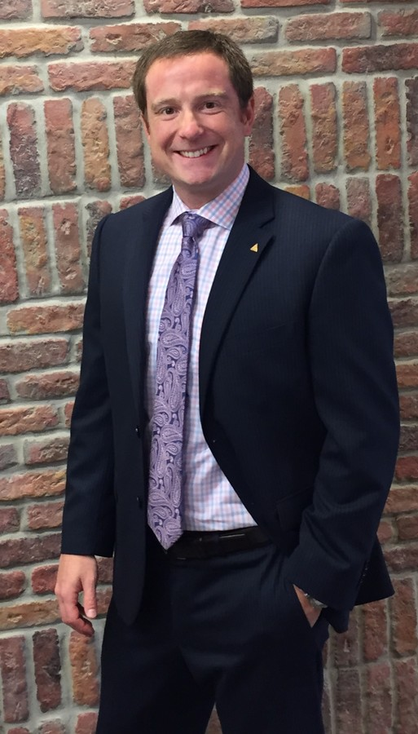
About Me:
Independent Insurance Agent
In the business for 15 years
Currently insure about 20,000 beds
In 20+ states
Directly assist NARR Affiliates:
FARR (FL)
GARR (GA)
SCARR (SC)
VARR (VA)
WVARR (WV)
PARR (PA)
OKARR (OK)
CARR (CO)
WAQRR (WA)

Slide 5
All Insurance is not the same
Main Street Businesses
Easy to insure
Behavioral Health/SUT/Recovery Residences
Not easy
All agents want to help you
Not all are capable of doing so
Not understanding the nuance of an industry is dangerous

Slide 6
Insurance vs Risk Management
Insurance
Risk Management
Risk Transfer
Paying to pass the risk
Doesn’t prevent the problem
Doesn’t make problem go away
Covers some/most of the cost of the problem
For what can be insured, insure it well
Not everything is insurable
Risk Financing
Spending to avoid the risk
Proactive
Prevention
Control
Insurance
For what can not be insured

Slide 7
You are already risk managers…
Driving a car
Asking someone out on a date
Buying organic produce
Ordering dessert
Shopping Online
Going to bed late
Having children
Going on a walk

Slide 8
Examples of Managing Risk
Catastrophe – Hurricane/Flood/Fire
Peer Location
Hotel Contract
Alternate Location
Financial
Tax Implication (Accountant)
Economy
Governmental Involvement
Regulatory
Rental Agreement (Lawyer)
New Laws
Zoning
Transfer
Insurance
Escrow
Corporate Structure

Slide 9
Insurance
“A ship in harbor is safe, but that is not what ships are built for” – John A. Shedd

Slide 10
What is it? (Caution, History Lesson)
The origins start in Edward Lloyd’s Coffee House
Now Lloyds of London
Sharing risk for merchant ships
Then underwriting investments
The premium of the many cover the losses of the few – still
Does not stop the bad day, it helps with the financial burden.

Slide 11
Coverages
General Liability – NARR Requirement
Not Homeowners
Common Exclusions (A&M/A&B/Prem)
Abuse & Molestation
Professional Liability
Property
Building, Contents, Loss of Income
What are the largest losses in the last two years?

Slide 12
Coverages (Cont.)
Auto
Owned / Hired & Non-Owned
Workers Compensation
W-2 vs 1099
Cyber Liability
Employment Practices Liability
Directors & Officers

Slide 13
Read Your Policy
Not all insurance policies are created equal. If you expect to insure your business the way you intend, it is imperative you adjust your budget to meet the coverage you want and not adjust your coverage to meet your budget.

Slide 14
In Conclusion

Slide 15
Questions?

Slide 16
Contact
Lee M Goldberg, MBA, CIC
888-728-0817
lee@bbimi.com
www.bbimi.com

