Slide 1
Communities Project Leadership Training
Ohio Recovery Housing
March 25, 2025
1:00 p.m. to 5:00 p.m.

Slide 2
Welcome & Introductions 1:00
Leadership Questions 1:15
Three Leadership Practices 2:00
Leading with Responsibility 2:15
BREAK 3:00
Self Reflection & Feedback 3:15
Speaking to the Leader 4:00
Next Steps 4:45
COMPLETE 5:00

Slide 3
Ground Rules
Interrupt me – not each other
Expect me to engage actively with your questions and thoughts
Participate freely – we all learn from each other
Please be prepared at the start of each session – our time together is limited and every moment counts

Slide 4
Welcome & Introductions

Slide 5
How You Are Here
As leaders, we are always investing in other leaders. We are constantly given opportunities to invest in others – to be an opportunity for them.
The same has happened for each of us – someone, some time in our lives, has made a contribution to us being here.
Please turn to a partner at your table, and share someone who is responsible for you being here?
Notes:
So one of the keys to effective storytelling – and this is largely derirved from the amazing work of Marshall Ganz, who I highly suggest you look up an dread some of his material – is that we tell public versions of our stories.
READ FROM SLIDE TO DISTINGUISH BETWEEN THE TWO
What types of stories must leaders tell to be effective?
How do we know what stories we must tell?

Slide 6
What have you always wanted to know about leadership but have never asked?
Notes:
Laszlo –chat box or raise hand.
MK Script:
Let’s start with all of you though. We all have our own perception of what effective leadership looks like, and we’ve all been exposed to people who we felt were strong leaders, and likely to people who we feel weren’t as effective.
What have you always wanted to know about leadership but were afraid to ask? Let’s have folks either raise your hands again, or put your question in the chat box. I’m going to start with raised hands and then go to any questions that come up in the chat box.
3-5 Questions or so

Slide 7
Three Leadership Practices

Slide 8
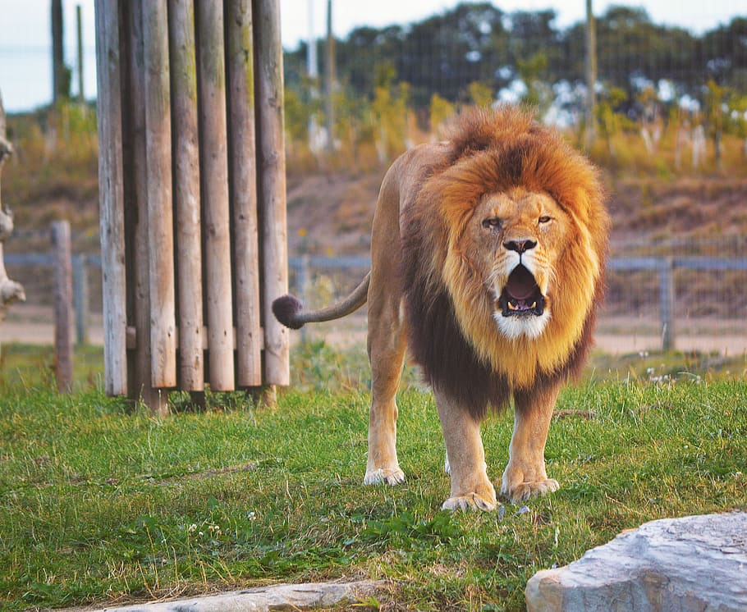
The Communities Project believes:
The potential for leadership exists in all of us
We do not “create” leaders
We lead effectively when we identify what is blocking us
Our conversation today will focus on how we break through the cages that hold us back from producing the results we seek.
Notes:
MK SCRIPT:
There are some fundamental ideas that drive the leadership theories of The Communities Project, and they are a centerpiece behind each principle we present in our trainings.
First off, the potential for leadership exists in all of us. This means that we do not “create” leaders. That is not what leadership development is all about – the idea that we take someone who isn’t a leader, and make them one. Leadership development is about how determining where and why we are caged, and putting principles into practice that will bust us out of these cages.
This means that everyone is born with an internal equality when it comes to leadership potential. But society builds a cage around us, and what that cage looks like can vary dramatically depending on our race, where we are born, what gender we are, our social class, or whether or not we have a disability . Racism contributes to that cage. Patriarchal policies contribute to that cage, generational trauma contributes to it. Now to be clear – it’s critical that we don’t blame these things for developing the cages we find ourselves in. We don’t blame – but we do recognize. And for a white man like me, I must both honor the cage that I can find myself in as leader while also being responsible for my white proviledge and how I choose to use it. This all contributes to the fundamental leadership theories that drive our work.
Children have natural leadership sense, and yet it is nurtured out of us. STORY ABOUT COOPER AND FIFA
Leadership development is not about creating a leader – our time together over the next two days is not going to focus on teaching anyone how to lead
Leadership development is about busting out of the cages we, and those around us, have built around us – bringing us back to the core instincts that we all have
This is what the trainings and webinars hosted by The Communities Project are all about– how do we break through our cages and produce the results we seek!

Slide 9
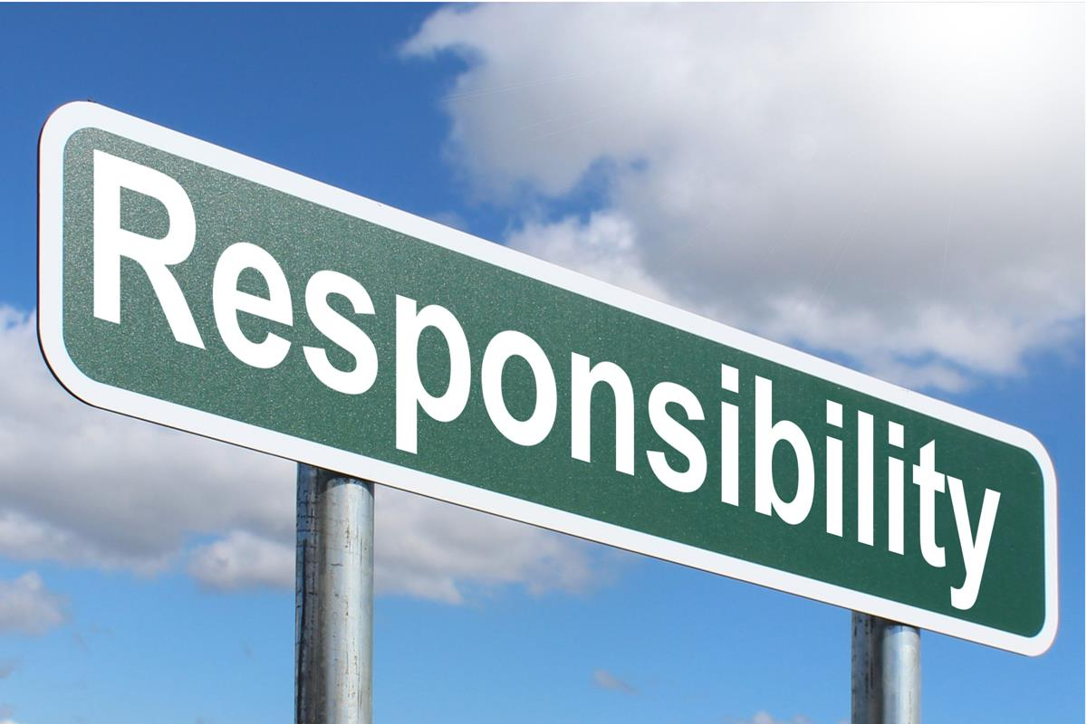
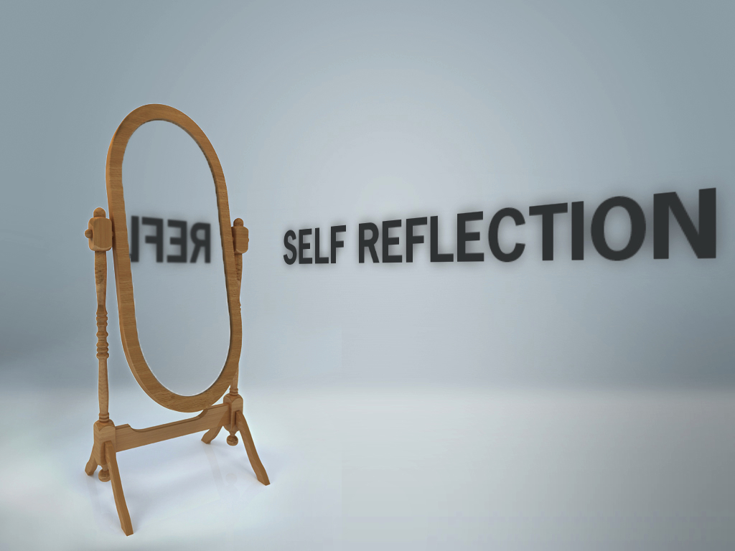
Three Leadership Practices
Leading with Responsibility
Being Self Reflective and seeking Feedback
Speaking to the Leader in Everyone
Notes:
MK SCRIPT:
So in order to bust out of our cages, there are three key principles to which we turn – and these principles will always get us “unstuck.”
Leading with Responsibility:
This means that we are responsible for the results we are producing. We own our contribution to those results, regardless of whether or not they were the results we hoped for.
Self Reflective & Feedback:
To understand what we’ve contributed to our results, we ask, “What was my contribution?” This is inherently a self reflective question. But there are limits to our own self reflection, so we must also seek feedback from those around us. The more feedback we seek, the more refined our practice of self reflection can and will become.
Speaking to & Investing in the Leader in Everyone:
We speak to the leader that lives in everyone around us. We use the language we’ve acquired around responsibility and self reflection in every dialogue we have with every person. We see the leader in everyone around us, rather than seeing someone to whom we can delegate responsibilities.
TELL LwC STORY – I HAD NEVER CONSIDERED THESE PRINCIPLES AND THEY’VE CHANGE MY LIFE
Before we dive deeper into each principle, what’s bubbling up for you thus far? Let’s see folks raise their hands or enter thoughts into the chat box.

Slide 10
Leading with Responsibility

Slide 11
Leading with Responsibility
Leading with responsibility means that we own the results that we are always producing, whether they are desired outcomes or not.
Leaders use responsibility language
“At our meeting today, I want to take responsibility for ensuring that
we remain on task and focused”
Leaders never place blame on others – they own their part of every conversation
“I want to take responsibility for not following up with you sooner.
If this task is going to get completed, my follow up is critical to that process”
What are you hearing for yourself regarding responsibility as a leadership principle?
Notes:
So let’s dive deeper into the idea of leading with responsibility.
When we are leading with responsibility, we see our success and failures as just RESULTS. This means we don’t put extra meaning on to things. SUCCESS just means SUCCESS. FAILURE just means FAILURE. We don’t judge either of these as GOOD or BAD. They are just RESULTS. And we are responsible for what we contributed to them.
We own our own contribution to the results we are producing. We focus solely on our own contribution, not the contributions that others are making. If we have staff and they are not coming through in the way we are hoping, we take responsibility for what we contributed to that. TELL STORY ABOUT MANUEL AND HOW HE WONDERED WHY STAFF WEREN’T DOING WHAT HE WANTED – COACHED HIM AND HE FIGURED OUT THAT HIS CONTRIBUTION WAS THAT HE WAS OFTEN LETTING PEOPLE OUT OF THINGS, AND THAT WAS HIS CONTRIBUTION TO THAT RESULT.
When we lead with responsibility, it means we are not a victim and we don’t blame others.
To be responsible, we focus on what actually happened...we don’t make up stories, or make things mean stuff. We simply live within the facts. Again, SUCCESS is just SUCCESS, and FAILURE is just FAILURE. Sometimes we see our “failures” as learning opportunities. However, we are careful about seeing our “failures” as just learning opportunity because that’s all about us - being responsible means that we own the impact the failure has on others. If I don’t deliver during our training time together, I can look at that and say, ”Oh well, I’ll do better next time” – but that doesn’t take into account the fact that you wasted your time. So I would have to be responsible for that.
It is critical to remember that we also have to be responsible for our success...when we reject praise from people, we aren’t listening (EXAMPLE: If you tell me I’m wonderful, I’ll just say, “Thank you”).
TELL STORY FROM MADISON
So I want to hear from you – what are you hearing for yourself regarding responsibility as a leadership principle? Laszlo is going to put up a white board – can you please share what is bubbling up for you here, and put your name or initials next to your thoughts, I’ll call on some folks then. Remember – EVERYTHING YOU SAY IS A CONTRIBUTION!

Slide 12
Small Group Discussion: Being Responsible for Success
In your small groups, please go around the table and discuss one result from YOUR recent work that has produced a success. You will have ten minutes for this conversation, so be mindful of your time.
Discuss what your contribution was in producing that result.
Small Group Discussion: Are your fellow group members taking responsibility for the results THEY are producing?
Notes:
Remember, as leaders, we are producing results in every conversation, every meeting, every action we take. If our volunteers are not following through, we are responsible for own contribution to that. If every event we have produced over the past month has been a smashing success, we are responsible for our contribution to that. We are responsible for what we’ve contributed to the relationships in our lives. We are always, always, always leading with responsibility.
So one of the assignments we gave you before the training was to think of a place in your work right now where you are successful, and also think of a place where you are stuck. Right now, I just want you all to think about that area where you are producing DESIRED results - SUCCESSES.
What we are going to do now is break you back out into small groups what I’d like you to do is go around the table, and I want you take responsibility for what YOU contributed to that result. So for example, I might say, “The event we hosted last week had a huge turnout, and my contribution to that was that I built a large coalition of partnering organizations who supported the event.” Now note – I’m not owning the coalition’s contribution, just my own – I built the coalition.
So everyone around the table should get a chance to share – remember, keep a time keeper at the table, you’ll have ten minutes for this. And for the rest of the table – hold yourselves accountable! Are you owning your contribution???

Slide 13
Small Group Discussion: Being Responsible for Stuck
Staying in your small groups, please go around the table and discuss one area in YOUR professional life where you are finding yourself stuck. You will have ten minutes for this conversation, so please be mindful of your time.
Discuss what your contribution has been in producing that result.
Small Group Discussion: Are your fellow group members taking responsibility for the results THEY are producing?
Notes:
So as leaders we are not only responsible for our greatness and what we are contributing to our success, we are also responsible for what we’ve contributed to situations where we are stuck.
By being responsible for what we are contributing to the areas where we are stuck, we open the door to shifting the results we are producing, and we also create a space where others can own their contributions to the areas they are stuck as well.
OK, so now we want to put everyone back into your small groups. Are you and your group members willing to take responsibility for your contribution to an area where you are stuck? Same thing, take ten minutes, everyone should share and group members – hold your fellow leaders accountable! By doing so, you’re making a contribution to them!

Slide 14
BREAK PLEASE BE BACK IN 15 MINUTES “I spend half my time comforting the afflicted, and the other half afflicting the comfortable.” -Wess Stafford

Slide 15
Self Reflection & Feedback

Slide 16
Being Self Reflective
Self-Reflection is the practice of examining what you are contributing to the results you are producing, and doing so absent judgement.
The events we have been hosting have low turnout - what is my contribution?
I am not growing in my position in the way I would like - how have I contributed to that result?
My co-workers are often critical of my job performance - what is my contribution?
Notes:
Again, thank you everyone for sharing your powerful thoughts! So let’s talk a little now about our second principle – self reflection and feedback.
To understand where we are responsible, we ask , what was my contribution? This is a self reflective question
Now Self reflection requires a willingness to be uncomfortable. In order to ensure that we don’t remain caged, we must be wiling to closely examine what we’ve contributed to the results we are producing. If I’m trying to find where I’ve fallen short with a colleague, it’s going to point to something in myself that brings up discomfort. How we show up for people is based on whatever stories we are telling about them – so perhaps if I’m not in a productive relationship with a colleague, the story I’m telling about them is what I’ve contributed to that relatikonship.
Now, I have to be non judgmental in looking at myself because if I am not, I’m just going to look externally...who wants to embrace a behavior that they are themselves judging? TELL STORY ABOUT KENLEY AND CHILD CARE. If I wasn’t willing to look at that situation from a place of non judgement, I’d sijmply avoid it and never find myself willing to change the behaviors that led to that result.
Now self reflection is about that inner vision, but it must be matched with a feedback practice.
Feedback is the external mirror – where self reflection is how I am seeing my contributions to the results I’m producing, feedback is about how I’m landing with other people. Do we all agree that leaders must land effectively with others? Can you mark YES or NO in the participant box? So remember, we cannot know how we are landing with others unless we ask.
Feedback is not the truth, and we do not get to argue with it. Can you all tell me what you think feedback really is? Please write in the chat box to everyone what you think Feedback really is? Let’s take a minute, every weigh in with what you think feedback is in the chat box – make sure you’re chatting with “EVERYONE.”
That’s all great, but FEEDBACK IS JUST FEEDBACK. Remember – we don’t add meaning to things. SUCCESS is SUCCESS. FAILURE is FAILURE. And FEEDBACK is FEEDBACK.
Perhaps most importantly, a consistent feedback practice will improve your practice of self reflection. We will engage in a feedback exercise tomorrow.
So let’s go to another white board here Laszlo – What are you all hearing for yourself regarding self reflection and feedback as a leadership principle? Again, pleas share your thought along with your name or initials.
3-5 PEOPLE.

Slide 17
Self Reflection & Feedback
Leaders are producing results every day. In order to understand the source of our actions and continue producing positive results (and understanding results that are less than favorable), we must build a leadership practice of self reflection that is:
Non-Judgmental of ourselves
Open-minded in order to see all there is to see
Willing to change and engage in new behavior patterns in order to produce different results
Notes:
So in order to best understand what you are contributing to the results you are producing (and therefore taking responsibility for them), we have to ask ourselves, “What was my contribution?” This is really the practice of developing and refining inner vision. By engaging in this practice, you can begin to understand what is REALLY blocking you from producing the results you want to produce – and buy doing this, you immediately shift away from the practice of blaming. By being self reflective and aware, you are able to actually be present in every conversation and every interaction that you have with those around you. And in order to be truly effective, you must be completely present (i.e. listening to others).
But it’s important o remember that self reflection as a leadership practice must be NON JUDGEMENTAL OF OURSELVES, OPEN MINDED, and then WILLING TO CHANGE.
We talked about this briefly yesterday – but why do you think it’s so important to be non judgmental of ourselves? Please RAISE YOUR HAND if you have a thought. (2 PEOPLE DISCUSSION) (IF NOBODY ANSWERS, “What are we doing when we judge ourselves? (WE ARE ADDING MEANING TO THINGS)

Slide 18
Small Group Discussion – Limits of Self Reflection
What might be some of the limits of Self Reflection?
5 minute discussion.
Notes:
Michael: Raise Hand for Discussion
MK Script: So we spoke a little bit about this yesterday, but I want to ask this question of all of you. What do you think might be some of the limits of self reflection?
PROMPTS:
What will self reflection NOT help you see?
Are you always the most objective observer of yourself?

Slide 19
Feedback – Self Reflection’s Partner
Leaders must seek ongoing feedback because self reflection will only take us so far.
Feedback is about how you land with THEM. It’s not the truth – IT’S JUST FEEDBACK.
When having a feedback conversation:
State that you are looking to enhance your leadership and feedback helps you understand your successes and shortcomings.
Ask for feedback, and remind the people you ask that everything they say is a contribution
Do not argue with or debate the feedback! Simply state, “Thank you, is there anything else?”
Notes:
MK Script:
We are only capable of being so honest with ourselves. We never actually know what other people are thinking and how we are landing with other people – we only know when we ask. Otherwise we are just telling ourselves a story about how we are landing.
Feedback actually keeps us grounded in the real world. It is about how we as leaders are landing with other people. And if we hope to be effective, it’s probably important that we are landing with them effectively! Does everyone here want to be effective? I’m going to go with “yes” – well if we want to be effective, we better ask for feedback from people. And the more feedback we solicit, the more refined our self reflective practice will become SO LONG AS we actually hear the feedback that is given.
Do you all remember what feedback is? Write it in the chat box – I can tell who has really been listening? IT’S JUST FEEDBACK.
We don’t get to argue with feedback – feedback is never “right” or “wrong.” There’s no such thing as “good” or “bad” feedback. It’s just feedback. It’s not the truth – but it is how we are landing with that person. They have a right to their own perception of us, whether we like it or not. But nearly ALL feedback is useful.
So when we get feedback from someone, we specific what we are looking for feedback on…on the slide here you’ll see the example of looking for feedback on your leadership in order to continue developing your leadership. You remind them that EVERYTHING they say is a contribution. And when they’ve given feedback, you don’t get to argue or debate it! You can ask a follow up question if something is not clear to you, but don’t argue with feedback! The only thing you can say to it is, “Thank you, is there anything else?”

Slide 20
Pair Share – Feedback Exercise
Please pick a partner and using the language outlined on the previous slide, please ask your partner if they have feedback on your participation today.
“I want to ask you what feedback you have on my participation in our training today– how have I showed up effectively, and where do you think I’m coming up short. Anything you say will be a contribution.”
You will have 5 minutes for this exercise.
Notes:
MK SCRIPT: So I want to give everyone the opportunity to practice a feedback conversation. Laszlo is going to pair you up with one other person here – remember, you’re powerpoint will not be available to view, so take a look at the one that I sent out yesterday. The question for which you can ask for feedback on is on the slide in front of you now – I want to ask what feedback you have on my participation in this training. Anything you say will be a contribution.” Then please hear their feedback – and remember, if you aren’t clear on what they mean, you can ask for clarification, but other than that, what is the one thing you can say? Throw it up in the chat box…AWESOME! So we’re going to give each pair eight minutes to have this conversation. Make sure each of you has a turn to go,
Alright, Laszlo, let’s break everyone out!
BACK FROM PAIR SHARE
Welcome back everyone! Would any pair be willing to share for the group? Just raise your hand.
ONE OR TWO PAIRS SHARE
Does anyone have any final thoughts bubbling up regarding self reflection and feedback as a leadership practice? Just raise your hand in the participant book. (TWO SHARES)

Slide 21
Speaking to the Leader in Everyone

Slide 22
Speaking to the Leader in Everyone
Leaders are focused on investing in everyone by speaking to them as leaders.
Be wary of advice –empower and speak to the leader in everyone around!
Listen before speaking - focus on what you are hearing from people rather than what your intent for them might be
Create opportunities for others based on what you hear from them
What are you hearing for yourself regarding speaking and investing in others as a leadership principle?
Notes:
Thanks again everyone! Finally, one last leadership principle – and both responsibility and self reflection lead directly into this one. And that is that uncaged leaders are ALWAYS speaking to and investing in the leader in everyone around them.
If you’re not investing in those around you, you’re doing something else. Creating followers can maybe be fun – but it’s not a leadership practice. When we are investing in those around us, we are inviting them into partnerships rather than delegating. For those of you who have direct reports, thing about how your relationship with them might change if you speak to them as a LEADER, or a PARTNER, rather than the people to whom you dish out tasks.
When we live this principle, every conversation is an opportunity because we are ALWAYS investing in others. We are making THEM the focus. When THEY are the focus, anything is possible. When I try to lead alone, I’m very limited. I think I’m pretty great, but I’m also just one guy. When I’m investing in everyone around me, the sky’s the limit.
Remember, we are not creating leaders here - we are investing in the leader who is already there. And part of we invest in other leaders is by leading with responsibility, and by being self reflective. Modeling those first two principles is critical in order to best practice the third.
So one more white board here – what are you hearing for yourself in regards to investing

Slide 23
By investing in the leadership of those around us, we will empower them to achieve greater results in their own professional lives.
This will:
Improve your relationships with everyone around you (coworkers, supervisors, peers, etc.)
Give you the opportunity to speak to the greatness in everyone
Empower others to not only improve their results, but improve the results of their communities
Notes:
So ff you see someone as a leader, it immediately shifts the way that you view them and how you speak to them. If you’re struggling in your relationship with someone, examine your contribution to that relationship – are you seeing them as a leader? Are you speaking to them as one?
Investing in the leadership of others means shifting your focus from yourself to the relationships you are building with those around you. By shifting your focus away from yourself, what I mean is that you become interested in what THEY WANT “FOR THEMSELVES rather than WHAT YOU HOPE FOR THEM. When we simply focus on what we hope for them, this means we are telling ourselves any story about another person that isn’t centered around them as leader.
If we successfully practice this principle, the results we produce can become limitless because:
1. When you’re surrounded by leaders, someone around you always has the answer or skill you do not posses
2. You see your own limitations as just another opportunity for someone else to practice their own leadership
3. When I am alone, I am limited – when I’m surrounded by leaders, I’m limitless
How do we speak to the leader in them? We start by practicing these first two principles. We take responsibility, we highlight our self reflection and ask for feedback. By speaking to those around us leaders, we speak to them as PARTNERS. We ask what they are thinking, we listen, and we reflect back on them.
What’s bubbling up for all of you around this idea? What questions are coming up? Raise hands and I can call on folks (TWO SHARES)

Slide 24
Role Play: Speaking to the Leader in Everyone
Please pick a different partner for this exercise.
For this role play, one participant will be a direct report, and one will be a supervisor.
The supervisor is wanting to have a weekly check in conversation with their direct report. Earlier this week at an event, ten volunteers were expected to turn out, and only three showed up. The supervisor must speak to the leader in the direct report in order to see what might happen in the future in order to produce a different result.
Please refer back to the responsibility & self reflection language!

Slide 25
Next Steps
Notes:
MK Script:
I want to thank everyone for your participation for Day One here today! Just a few more minutes together here today.

Slide 26
Online Follow Up Sessions
We will host online follow up sessions on the following dates!
Friday, April 11th – 10am to 12pm
Friday, April 25th – 10am to 12pm
We will send calendar invitations to you so you will receive the zoom link for these sessions.
Notes:
MK Script:
So what happens with The Communities Project and you after the training today? First, Laszlo is going to put a survey up in the cjhat box right now. Please – we need your feedback! I don’t think we’ve ever done a training that didn’t include at least one piece of feedback we got from the previous training. So please please please – take five minutes and fill out that survey. If you miss the link in the chat box, I will also be emailing it out to each of you later this evening.
But we hope our relationship with you does not end after today. We want to hear how you are planning to use these principles in the work you do moving forward. So, here is my commitment to each of you. I will personally reach out to each of you by the middle of next week. First, I will be sending yiou a certificate of attendance for attending our two day virtual leadership training. Second, I’ll want to set up a time to chat with you one on one, SO LONG AS YOU THINK A CONVERSATION WOULD BE USEFUL TO YOU. In that conversation, I want to hear more about the work you are doing, and how you might be interested in putting these leadership principles into play. Again, we have no hidden agenda here. We are just interested in you, and in the results you produce. So if that conversation sounds like it interests you, and you want to begin a coaching dialogue with us, please keep your eyes out for an email from me by mid next week. This is how we save a million lives – we invest in leaders like you!

Slide 27
Final Thoughts
What is bubbling up for you as we wind down our session today?

Slide 28
COMPLETE
IF YOU HAVE ANY QUESTIONS, PLEASE EMAIL
michael@communitiesproject.org

