Slide 2
Problem Gambling services overview
March 20, 2025

Slide 3
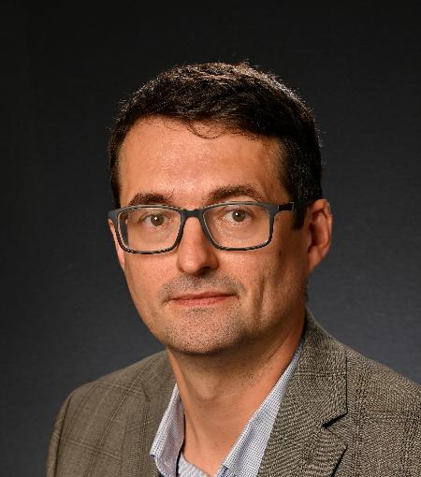
Problem Gambling services overview
Presented by:
Milan Karna, OCPC
Program Manager of
Problem Gambling
OhioMHAS

Slide 4
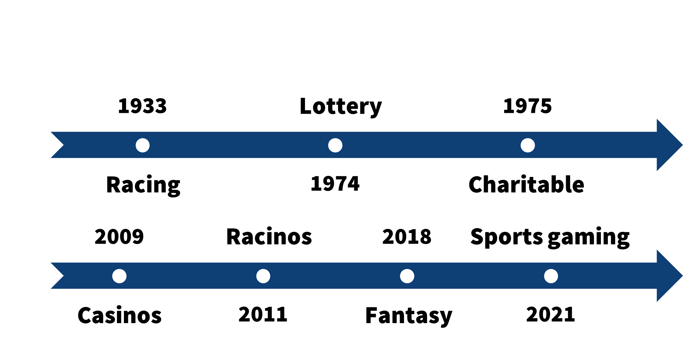
History and formation of org

Slide 5
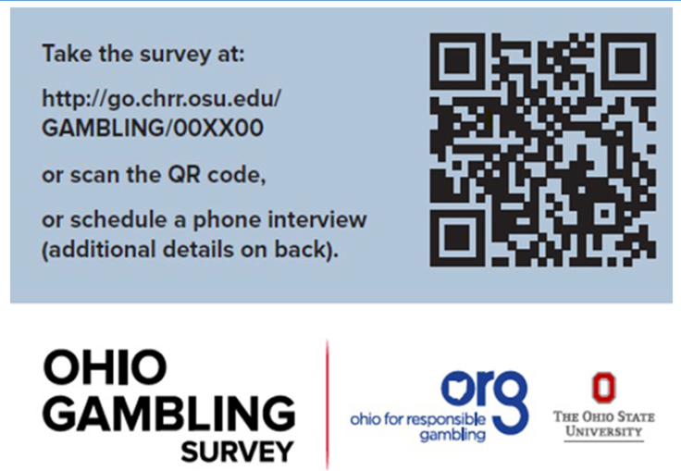
Ohio gambling Survey

Slide 6
Ohio gambling survey
•Aimed to reach 15,000 total Ohioans over the age of 18 in 50 ADAMHS Board Areas (~300 in each area)
•Gambling prevalence/behaviors
•Survey instrument adapted by Ohio PGAB
•Surveys conducted by OSU CHRR via postcard invitation (online)& phone calls
•Conducted from October to December 2022*

Slide 7
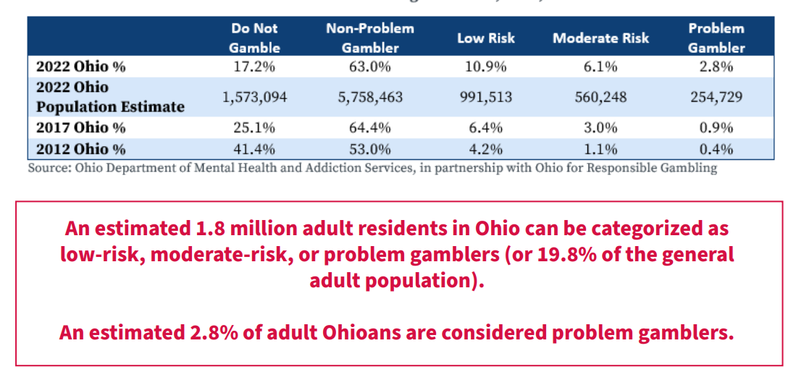
Ohio gambling survey

Slide 8
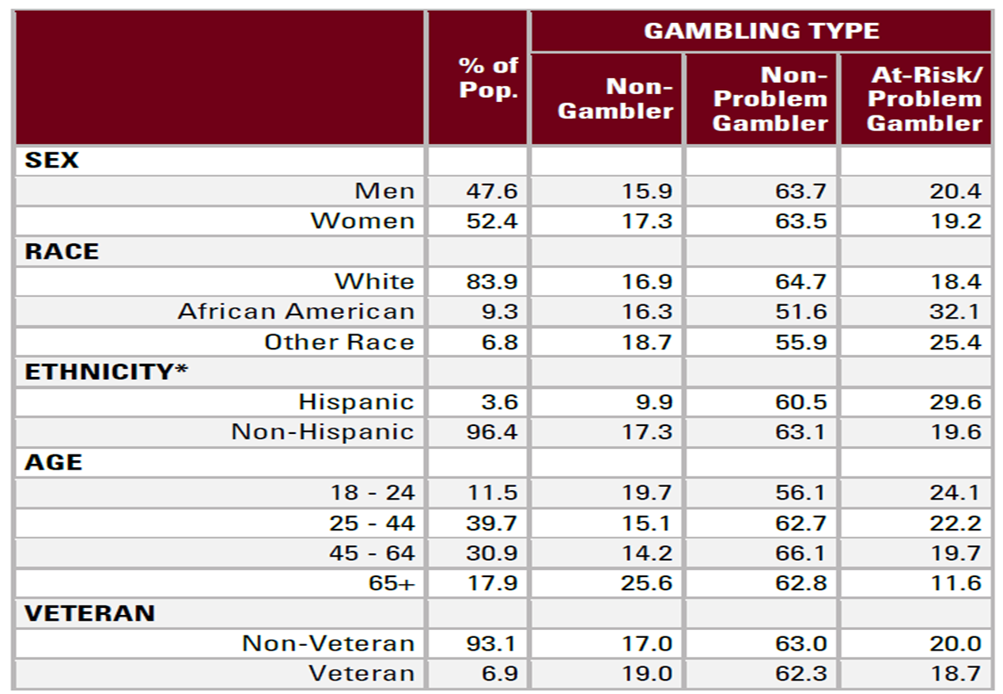
OGS Demographic information

Slide 9
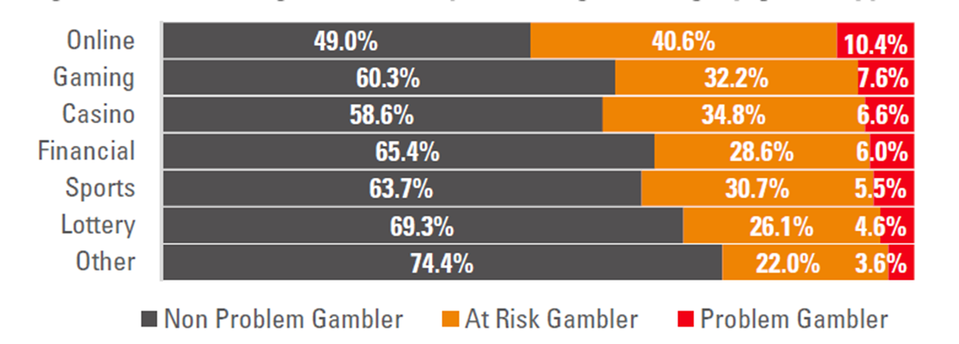
Percentage of at-risk/problem Gambling by Type

Slide 10
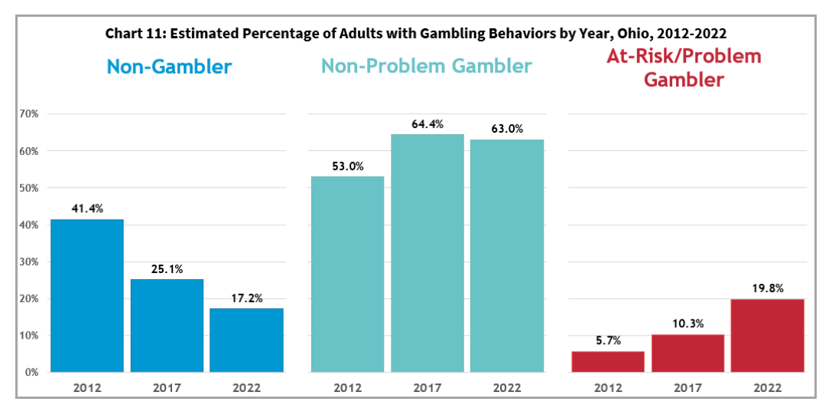
Ohioans PG Risk Level

Slide 11
Coming soon: Ohio sports betting survey
-Survey questions supported by OhioMHAS with input from ORG
-RFP supported by Ohio Casino Control Commission
-Survey will be conducted in 2025
-State and Behavioral Health Region data will be available

Slide 12
Ohio for responsible Gambling
Ohio for
Responsible
Gambling

Slide 14
Director
Community Planning & Collaboration
Financial Management
Public Affairs
Legal Services
Pharmacy Services
Medical Director
Treatment Services
Hospital Services
Community & Family Resilience

Slide 15
Programming
Board Allocations
Best Practice Sites
Problem Gambling Helpline
Set aside for OGS Survey
Workforce Development
Coalition Support
Ohio Gambling Telehealth Network
Treatment Shortfall
Awareness Campaigns

Slide 16
Ohio Workforce
Development

Slide 17
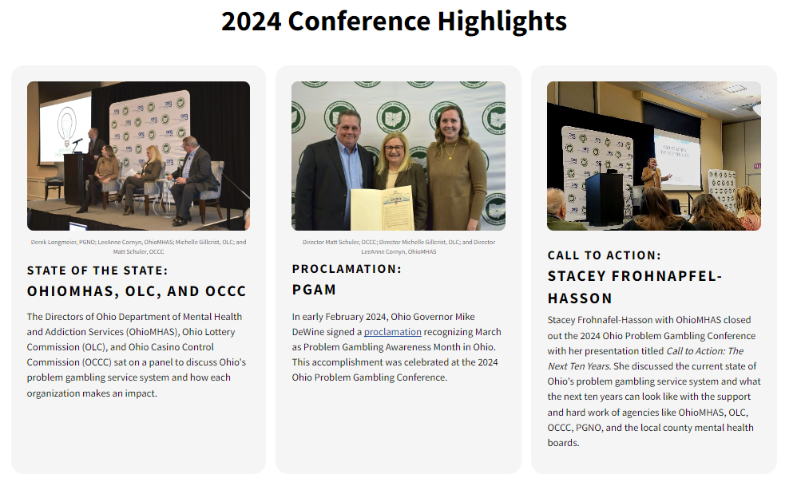

Slide 19
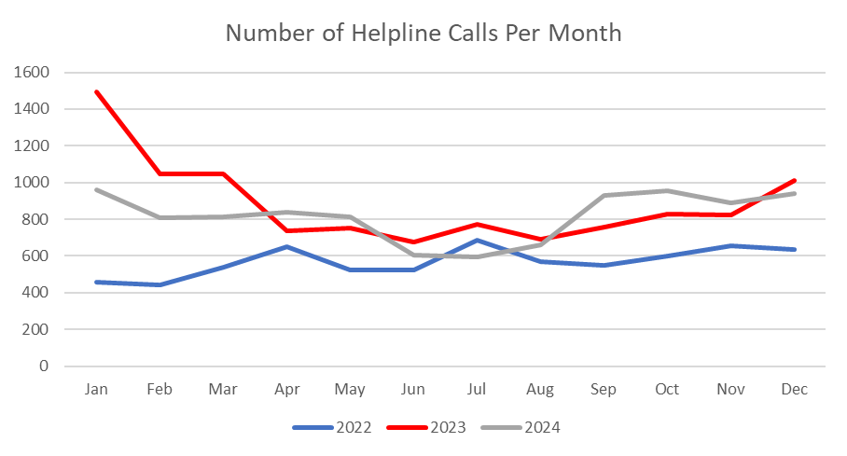
PG Helpline

Slide 20
PG Helpline

Slide 21
OHIO Gambling Telehealth Network

Slide 22
OGTN

Slide 23
Ohio Athlete Wellness App

Slide 25
Campaigns

Slide 26
PAUSE BEFORE YOU PLAY

Slide 27
CHANGE THE GAME OHIO

Slide 30
THANK YOU

Slide 31
Continue the conversation
Milan Karna, OCPC
milan.karna@mha.ohio.gov

