Slide 1
OXFORD HOUSE
Peer-Support Recovery with Proven Success

Slide 2
ORIGIN
The first Oxford House was opened in Silver Spring, MD in 1975.
Since then, Oxford House has expanded to:
4,100+ Houses
34,000+ Beds
47 states
6 Countries
No one ever asked to leave without cause.
Houses available to:
Men
Women
Women & Children
Men & Children

Slide 3
Three Core Principles
Oxford House Inc. Charter Requirements:
Democratically ran
Financially self-supporting
Immediate expulsion for relapse
Also:
Gender-specific
Minimum of 6 adult beds
Adherence to Oxford House Model, Traditions & Manual

Slide 4
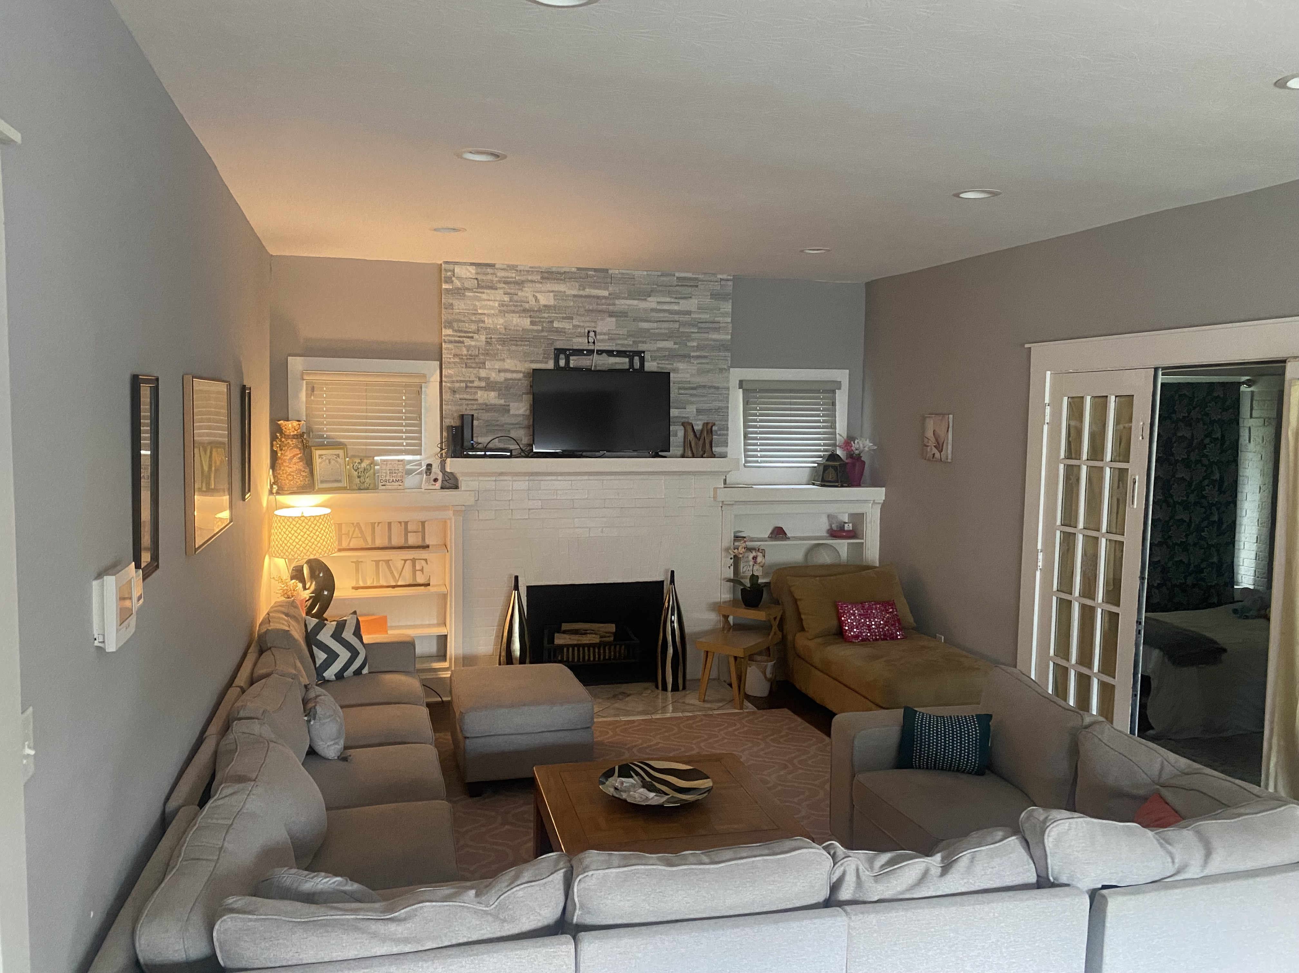
HOUSES
Large homes
Nice neighborhoods
Long-term leases
Adequate parking
Close to public transportation
Close to employment
Close to 12-step meetings, out-patient treatment, and other recovery resources

Slide 5
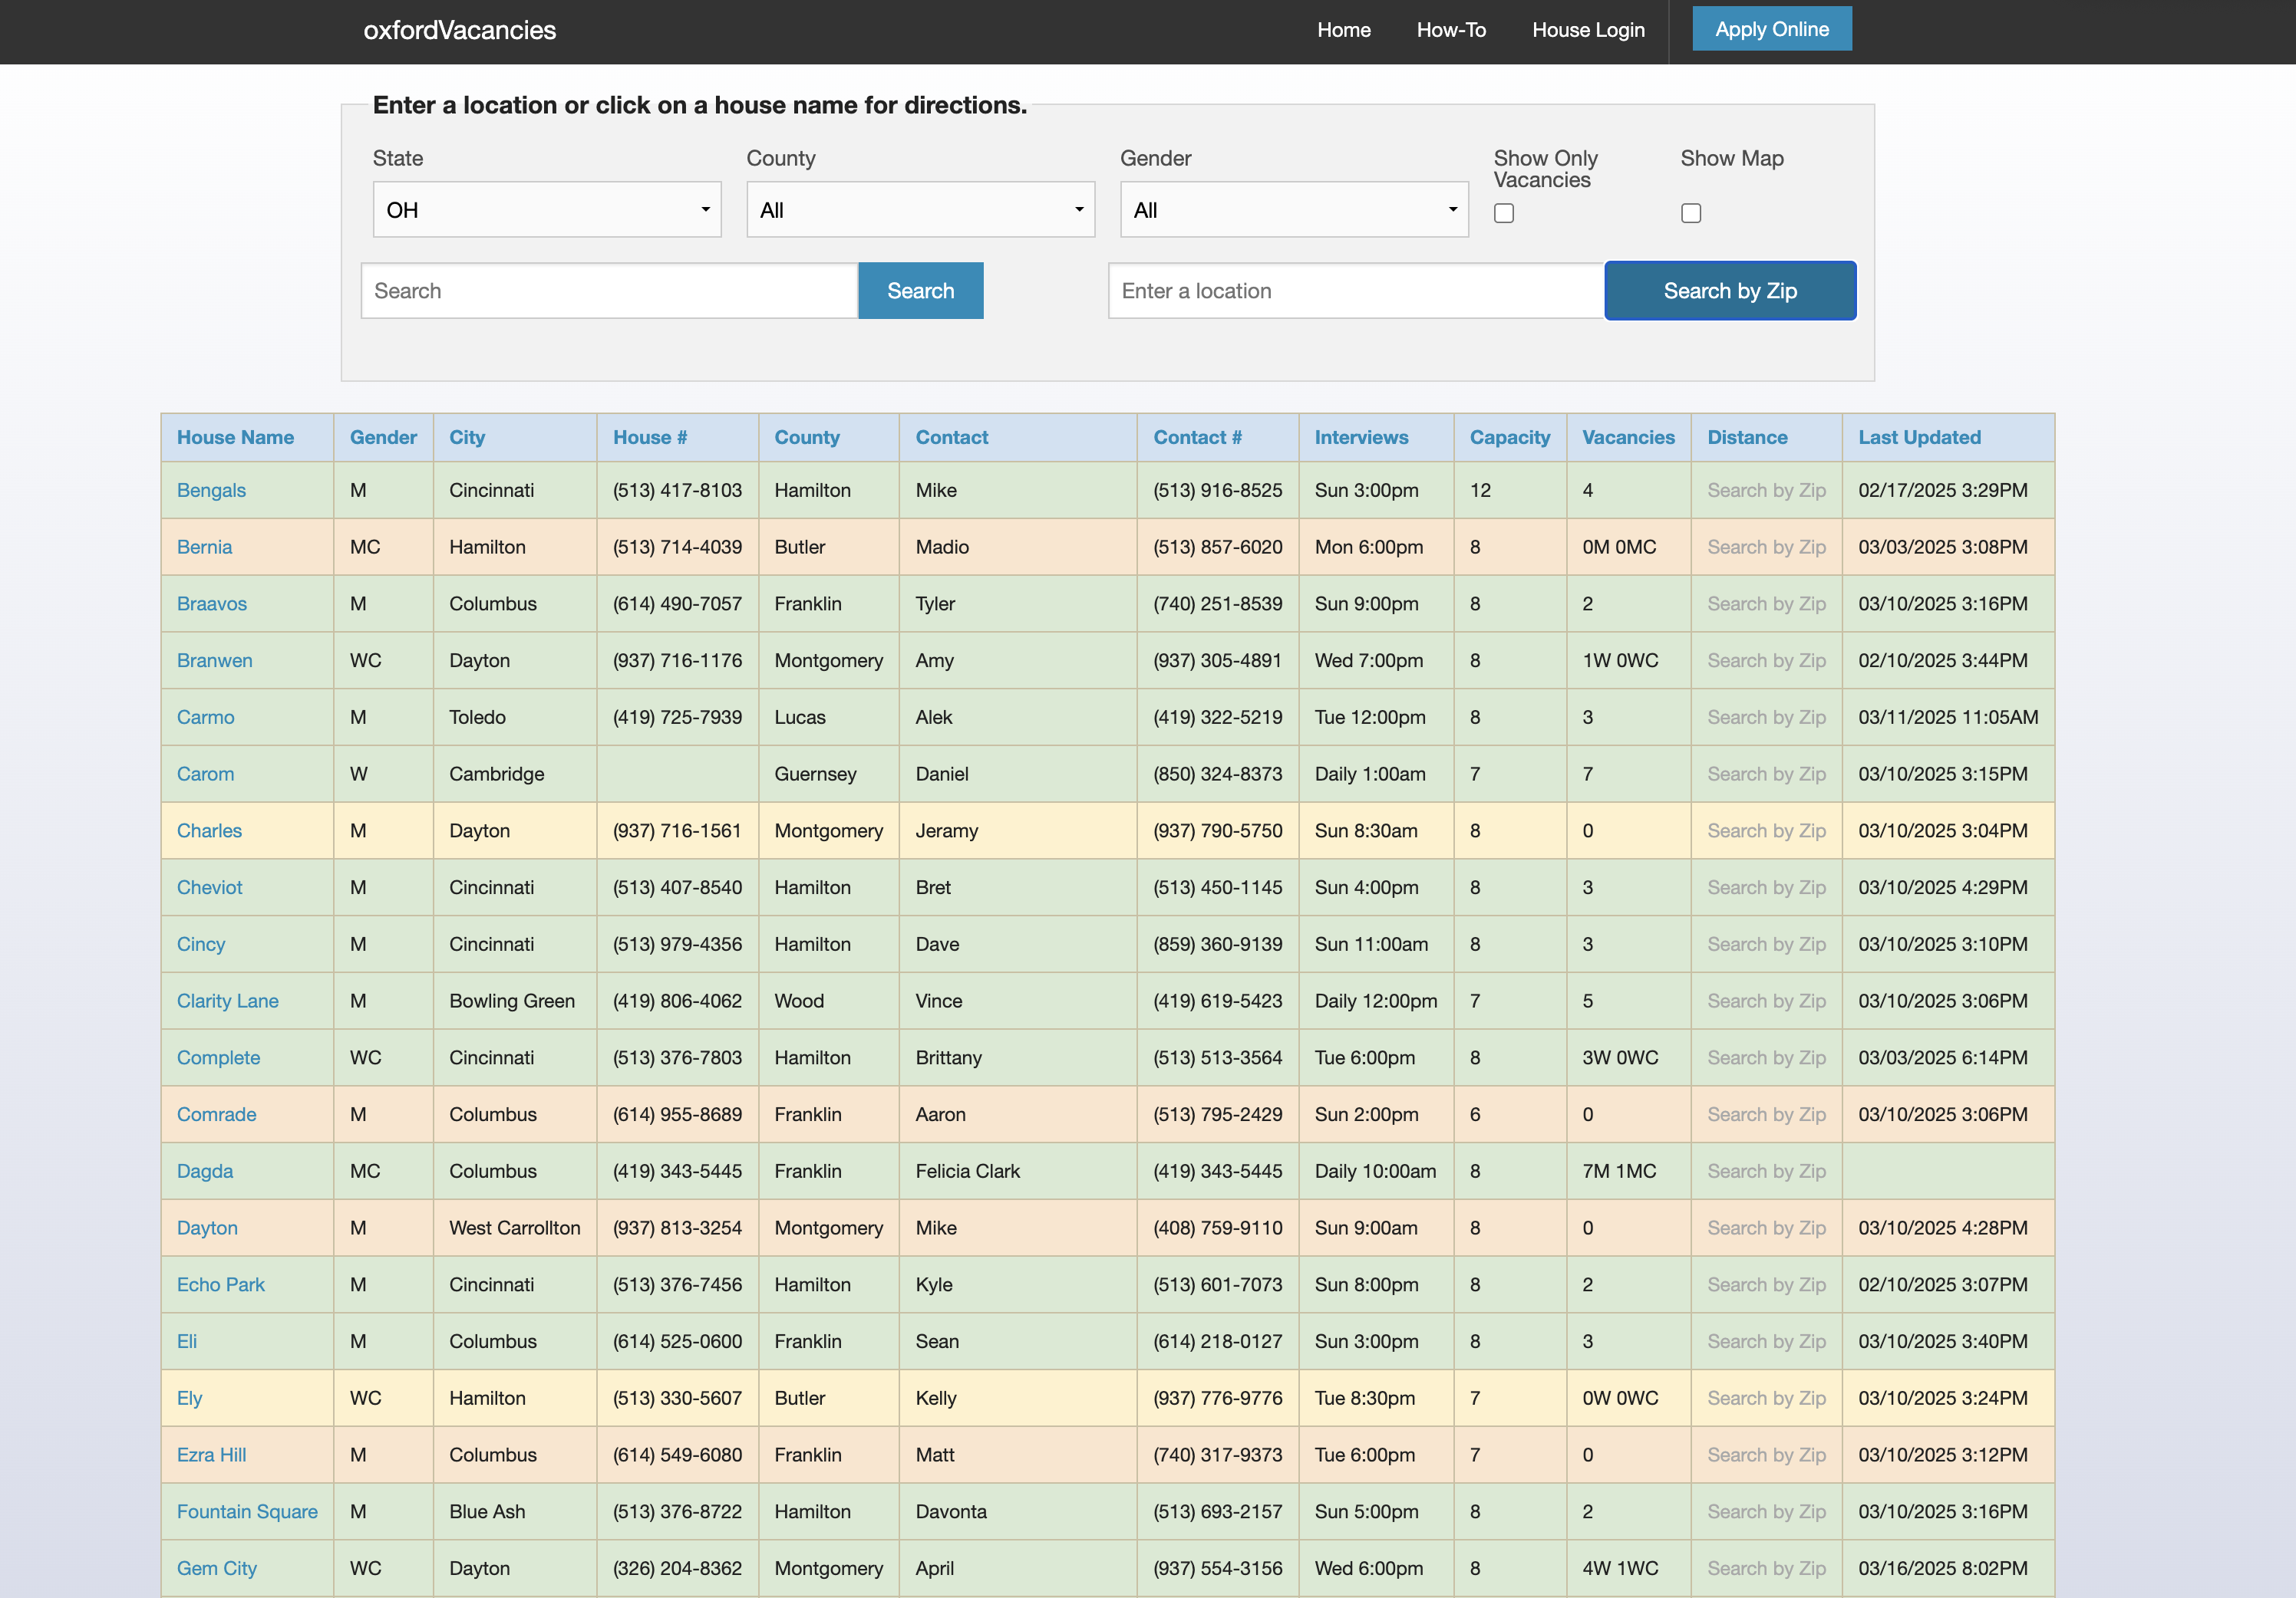
VACANCY WEBSITE

Slide 6
BECOMING A MEMBER
Fill out application (www.oxfordvacancies.com)
Call a house to set-up an interview
Show up on time for interview
Be open and honest during interview
Acceptance = 80% yes vote by members
If accepted, new member may move in as soon as possible.

Slide 7
STRUCTURE
50 years of experience
Three core charter requirements
Nine traditions to follow
House Manual
Chapter support
State Association support
Alumni support
Outreach support (Technical Assistance)
Oxford House, Inc. Support

Slide 8
STRUCTURE
House Meeting
Weekly
Parliamentary Procedure
Democracy in action
Financial decisions
Contracts
Majority Rules
How goes it

Slide 9
STRUCTURE

Slide 10
OUTREACH SUPPORT
Traveling to Communities throughout the country and abroad in need of the Oxford House model as a resource
Networking with local community members, organizations, and agencies
Establishing new Oxford Houses as part of a community effort
Presentations and more presentations
Connecting Oxford Houses to Support Networks

Slide 11
COMPLAINTS
info@oxfordhouse.org
Brittany Allen, Regional Manager (Ohio) – Brittany.Allen@oxfordhouse.org

Slide 12
Oxford House Fountain Square
Cincinnati (Blue Ash)
8 men

Slide 13
Oxford House Lerose
Columbus (Georgesville)
8 Men

Slide 14
Oxford House Toledo
- Sylvania
9 Women (2 beds for women with children)

Slide 15
Oxford House Rock and Roll - Cleveland (Middleburg Heights) - 8 Women (2 Beds for women with Children

Slide 17
QUESTIONS AND ANSWERS

