Slide 1
Preparing for Certification Review

Slide 2
Objectives
Discuss how to prepare for your onsite interview
Learn what happens when we visit onsite
Discuss physical property requirements

Slide 3
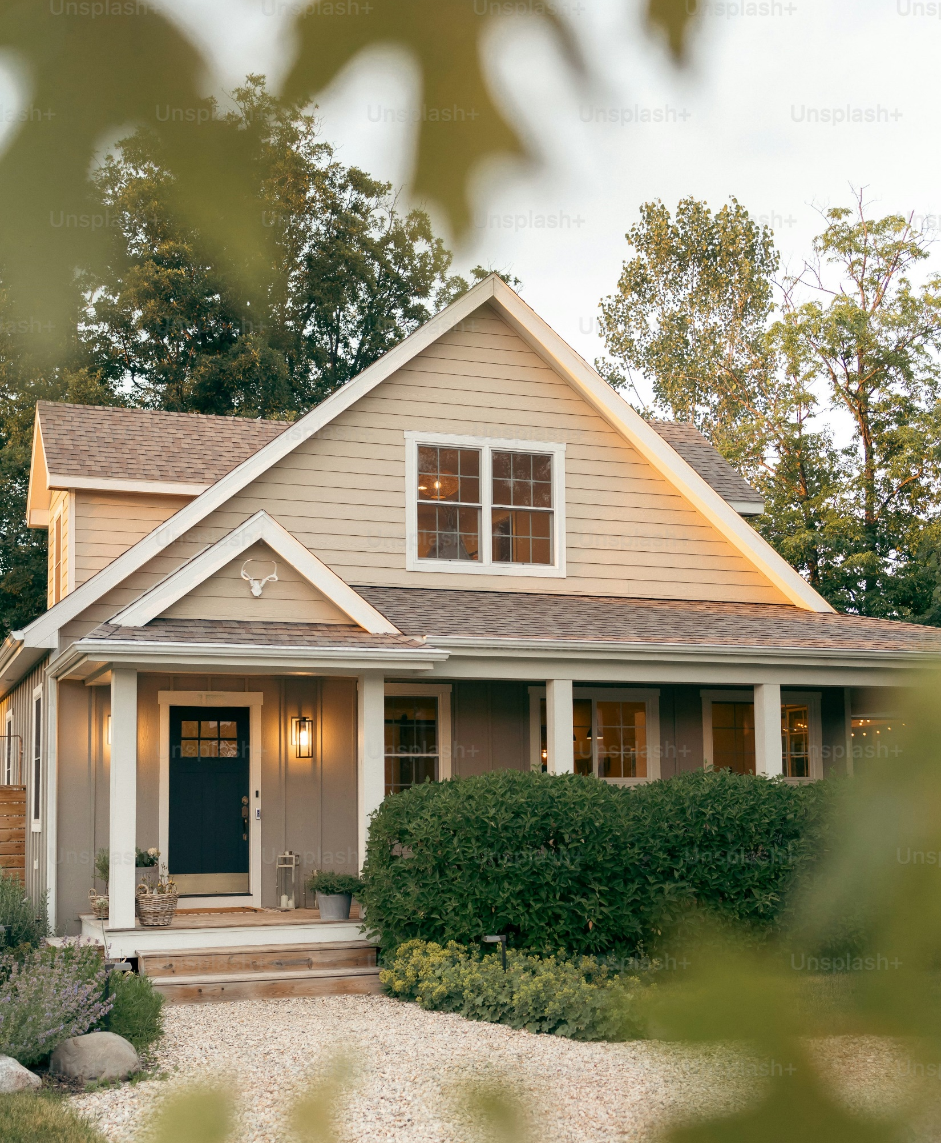
What is Recovery Housing
"Recovery housing residence" means a residence for individuals recovering from alcohol use disorder or drug addiction that provides an alcohol-free and drug-free living environment, peer support, assistance with obtaining alcohol and drug addiction services, and other recovery assistance for alcohol use disorder and drug addiction.” – ORC 5119.01(A)(17)
Notes:
So first, to level set a bit. I want to make sure that everyone on this call knows that we are talking about recovery housing. Recovery housing is…
We are NOT talking about residential treatment, we are NOT talking about adult care facilities, we are talking about recovery homes, specifically recovery homes that are seeking to meet the National Alliance of Recovery Residences Standards.

Slide 4
These slides are not the standards!
Please see the full measures for a complete accounting

Slide 5
Physical Property is Just one Element of the Quality Standards

Slide 6
Read the Assurances!
When you sign this document you are attesting to ORH that you
Are following all of your local building codes
You have a process in place to consider reasonable accommodations
You are following all employment laws
You are not engaging in kickback or inducements

Slide 7
How to do basic research on your building and zoning codes
Google the name of your city and building and zoning code
Find out what zone your property is in
Check the building codes to make sure you are in compliance
Call your local building department with questions

Slide 8
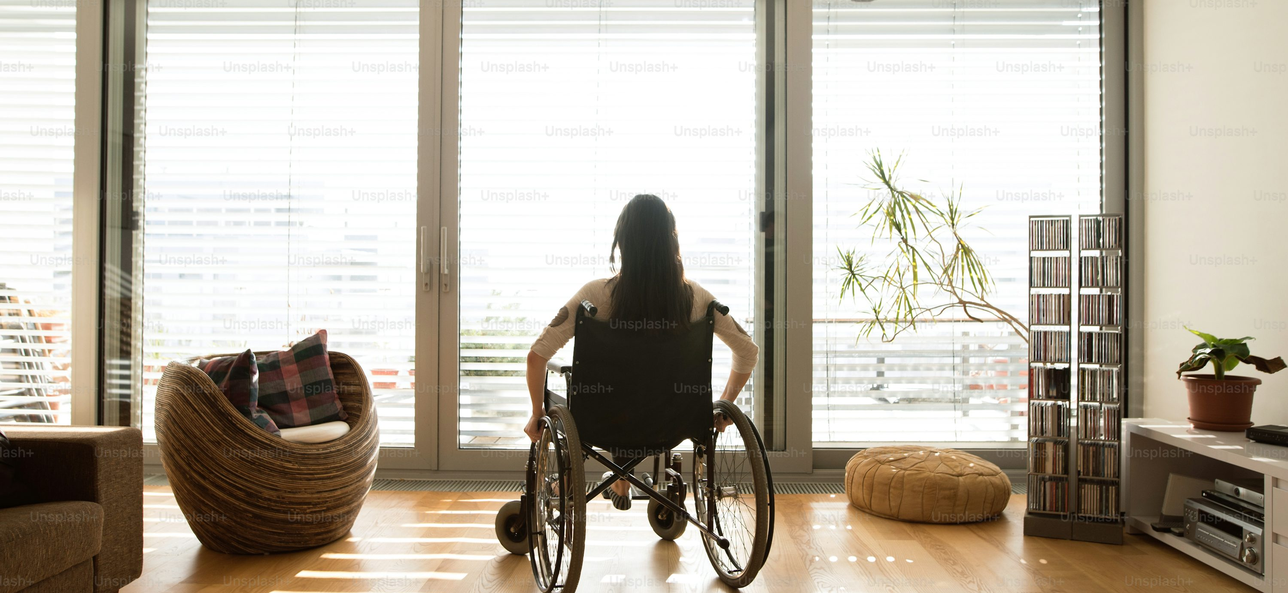
Making Reasonable Accommodations for people with disabilities
The same Fair Housing Laws that protect you against unlawful discrimination from cities also requires you to uphold the rights of residents
You must have a process in place to consider reasonable accommodations from people with disabilities
This includes
People who are taking a prescription medication as prescribed that you have on a “do not allow” list
People who need a physical accommodation
People who need materials in a different format/ read to them

Slide 9
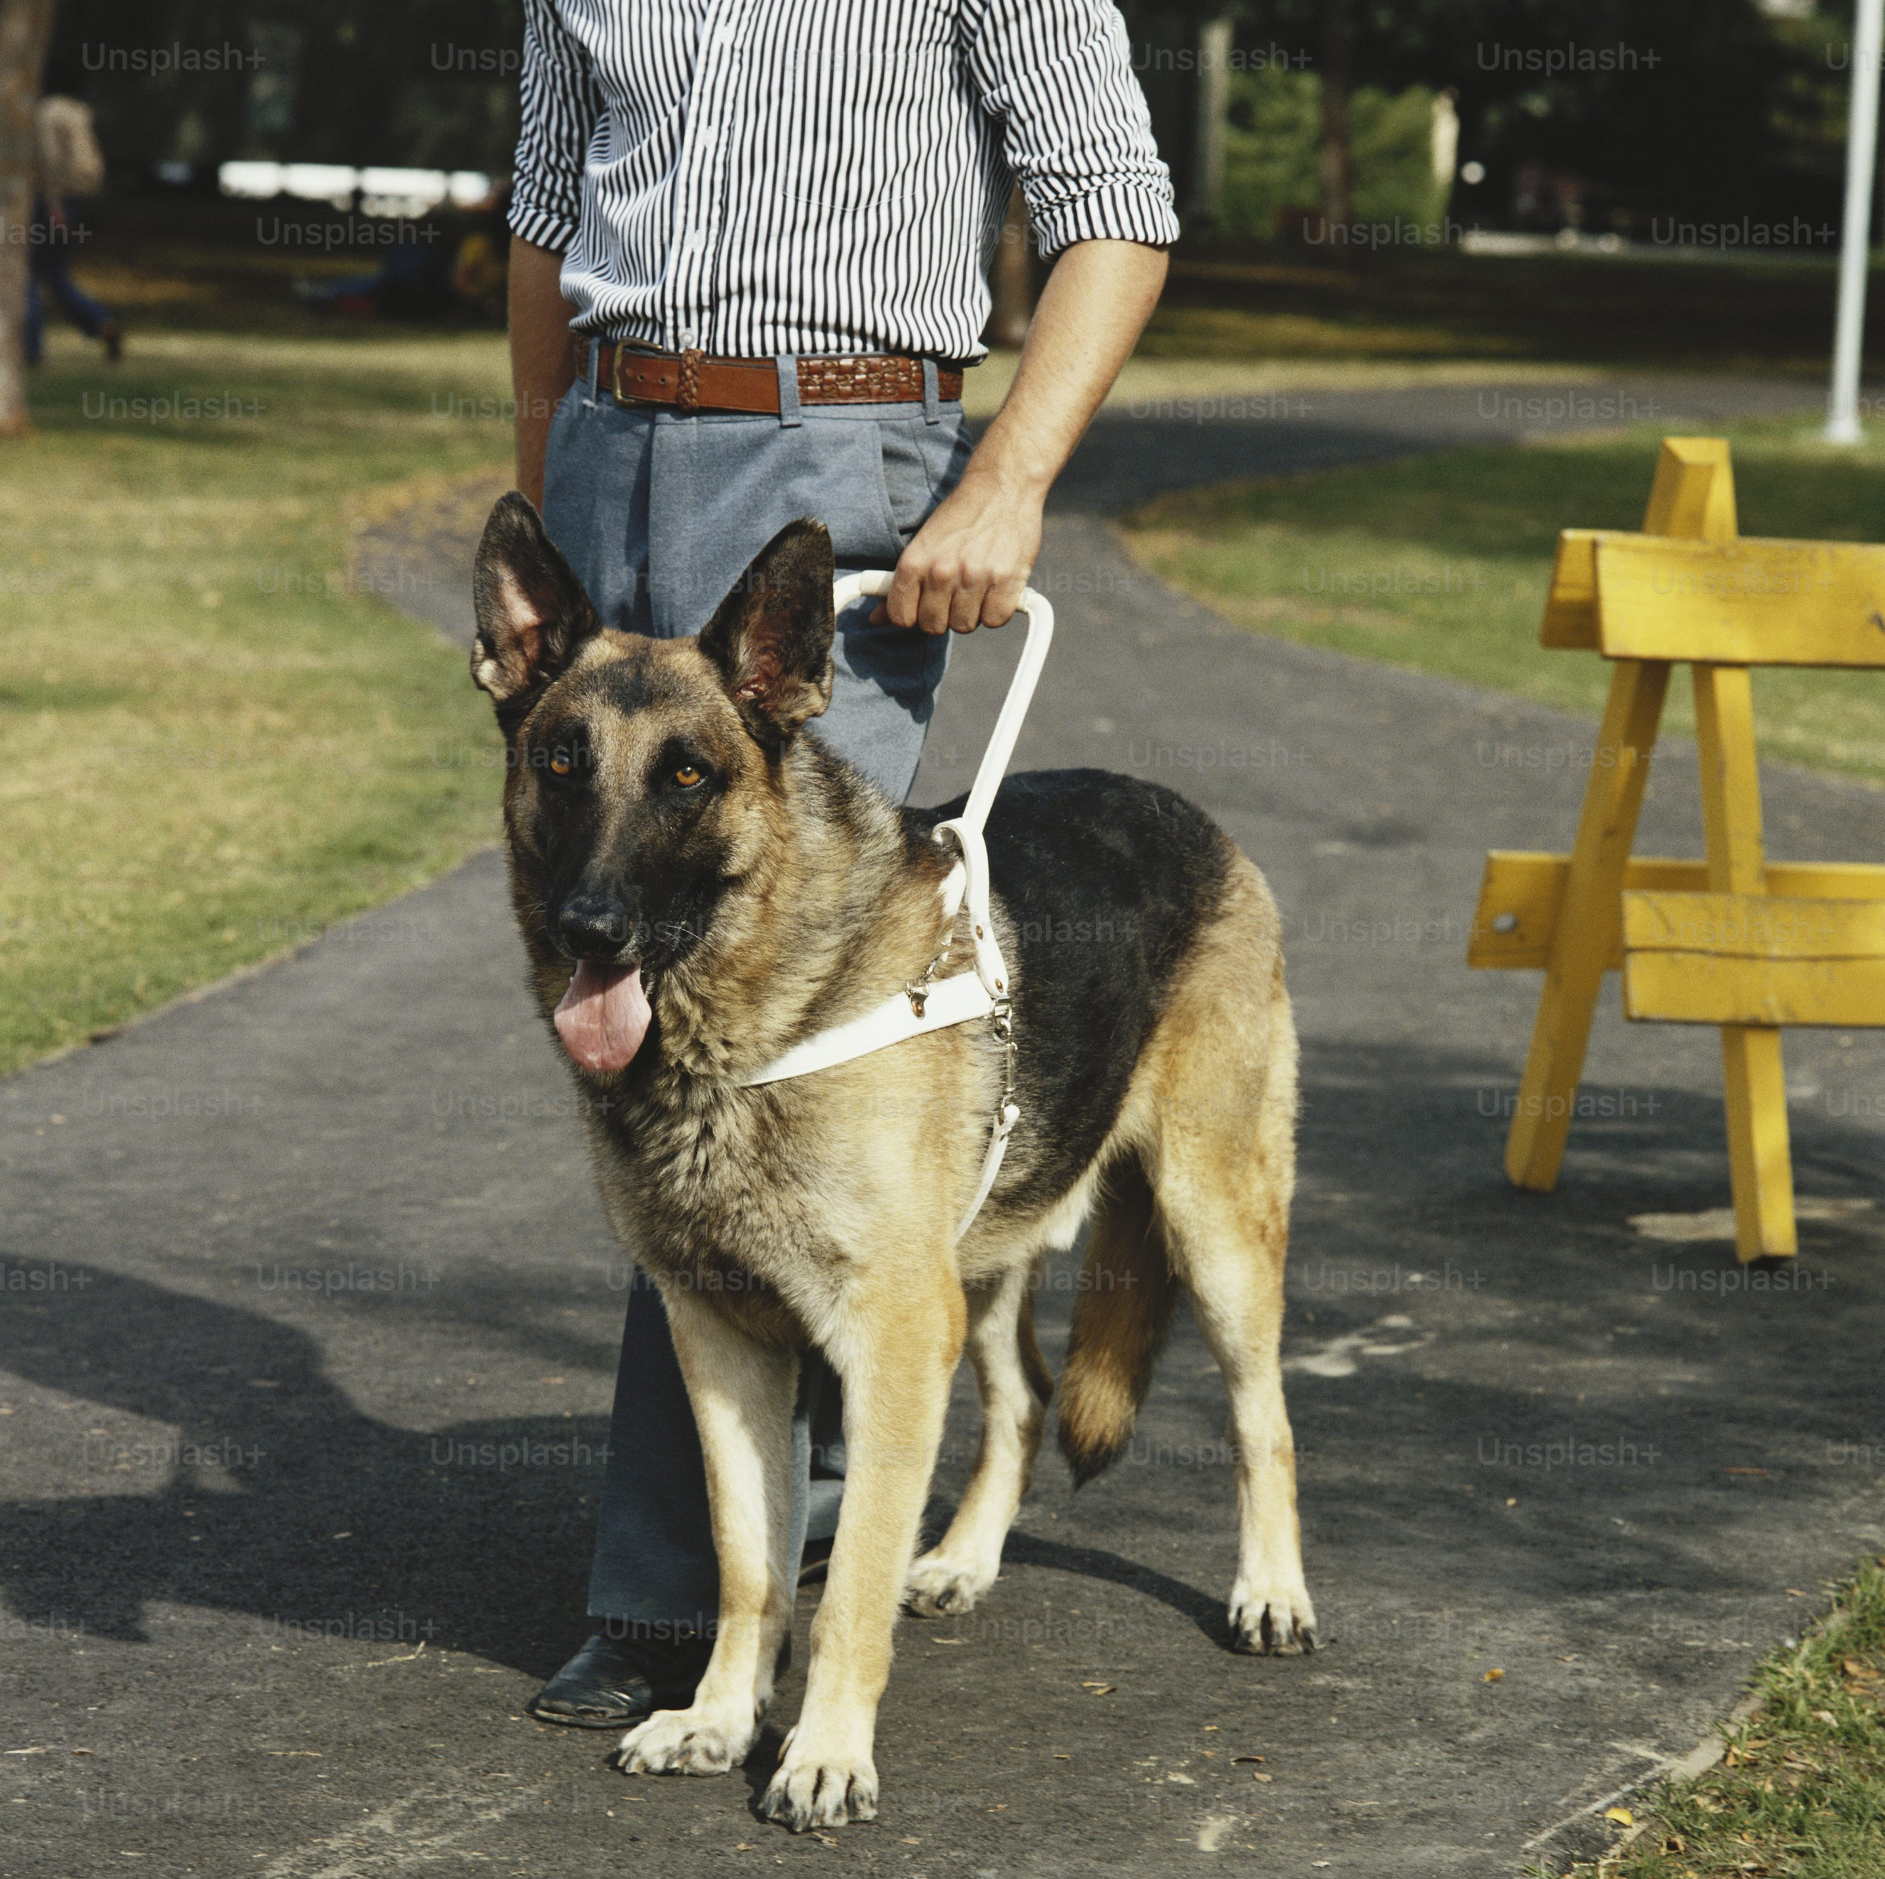
Yes! This includes service animals
You are not required to give individuals everything they ask for, but you are required to have a process where you
Engage in a good faith effort to accommodate the person
Document the request, your decision, and the basis of your decision

Slide 10
Your ORH Certification does not override state, federal, or local laws

Slide 11
First Component of your review is an interview
You will have to answer questions
You see exact questions we ask on our website
Example – “Imagine I am a new resident moving into the home, what would I be doing?”
You will have to show us the written policies and forms that you use

Slide 12
Once your application is accepted to move forward, TRAIN YOUR TEAM

Slide 13
Need help with developing or editing policies?
We have a training series for you!
Starts April 14
Ten total sessions
Helps you get all of your policies in order

Slide 14
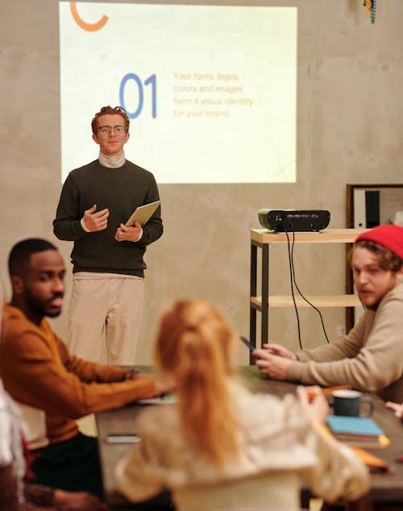
You must train your staff
If we arrive onsite and staff are not familiar with policies, it will be a problem
You will be required to train them, document training
We may even have to reschedule another interview

Slide 15
Questions?

Slide 16
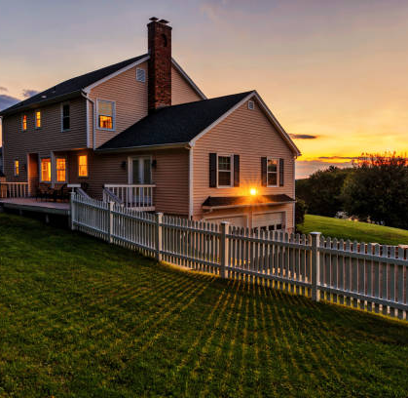
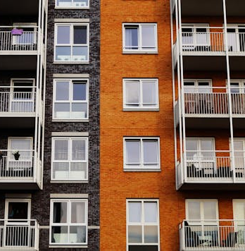
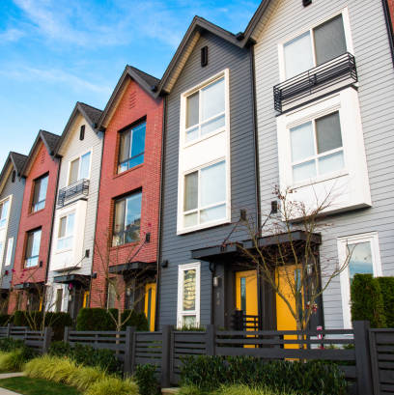
What types of buildings can be used as recovery homes?
Recovery housing residents live as a functionally equivalent family
If a family can live in the building, recovery housing residents can live in the building

Slide 17
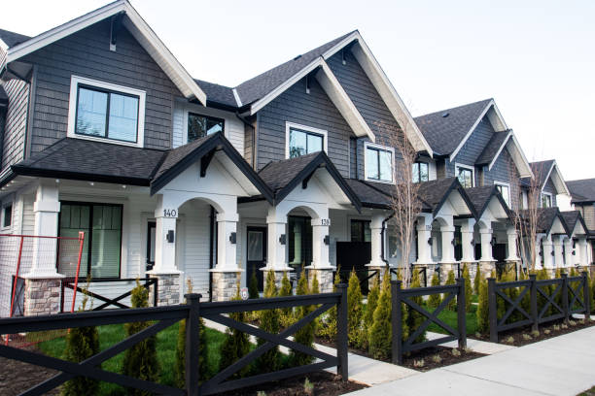
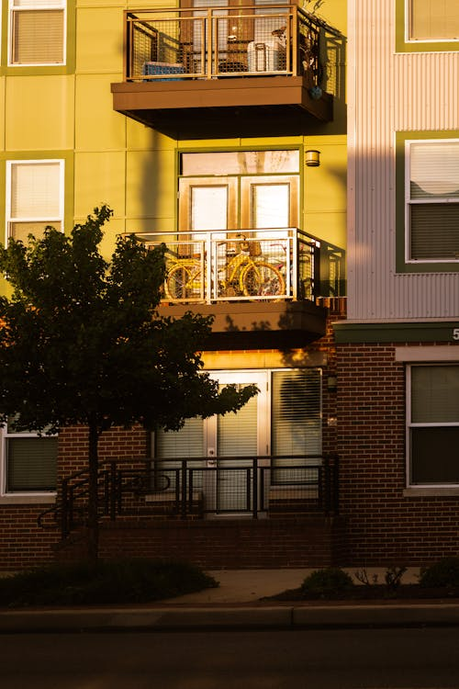
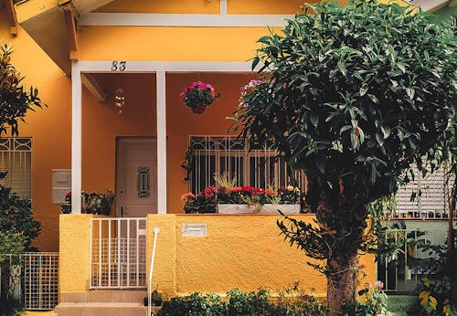
This means that homes can be
Single Family Homes
Duplexes
Apartment Buildings
Buildings repurposed to be housing

Slide 18
Capacity
Minimum of 3 residents
OR
Larger recovery environment made of multiple dwellings that creates an environment of peer support

Slide 19
Maximum Capacity
Dependent on
Number of Bathrooms (1 sink, 1 shower, 1 toilet per six residents)
Size of Bedrooms (70 sq feet for first person, 50 sq feet for each additional)
Size of Dining Areas
Size of Living/Common Areas
Amount of Food Storage Space

Slide 20
Please contact us if you have a unique layout or home
We are more than happy to answer questions
We advise to participate in the review and let us see what the space looks like
We are much better and coming up with creative ways to meet the standards if we can
Learn about your program
See the space
Understand how things work while we are there

Slide 21
Questions

Slide 22
Outdoors
Property is smoke free OR designated smoking area outside with appropriate container
Yard is free from trash
Any external structures are safe
Any fencing is in good repair and safe
No indoor furniture used as outdoor furniture
Doors to come are in good repair and safe
Exits are not blocked for purpose of egress

Slide 23
Documents
Copies of the following policies must be in a common area of the home
Emergency
Medication
Visitor
Resident Rights/ Grievance
Communicable Disease
Neighbor Concerns
Code of Conduct

Slide 24
Compliance with home’s medication policy
If the policy mentions lock boxes, lockers, secure storage, we will need to see those
Medications should be kept secured

Slide 25
Overdose Reversal Medication
Must be onsite
Not-expired
In a common area

Slide 26
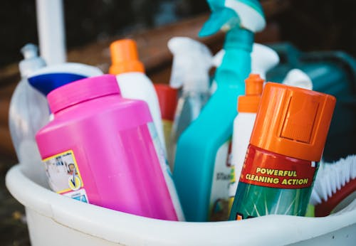
Cleaning Supplies
Vacuum or broom and dustpan
Mop and Bucket
Sponges, cleaning rags, or paper towels
Cleaner for kitchen counters and bathroom sinks
Toilet brush and cleaner
Soap to wash dishes

Slide 27
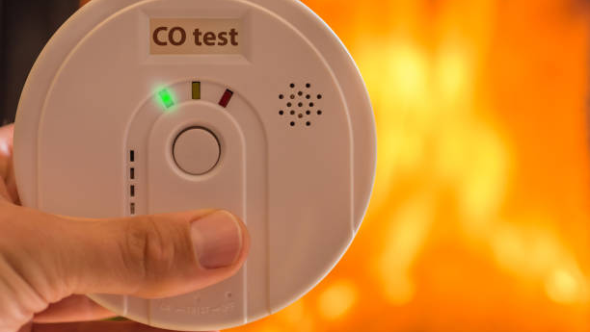
General
Carbon Monoxide Detector
Heating and Hot Water are available

Slide 28
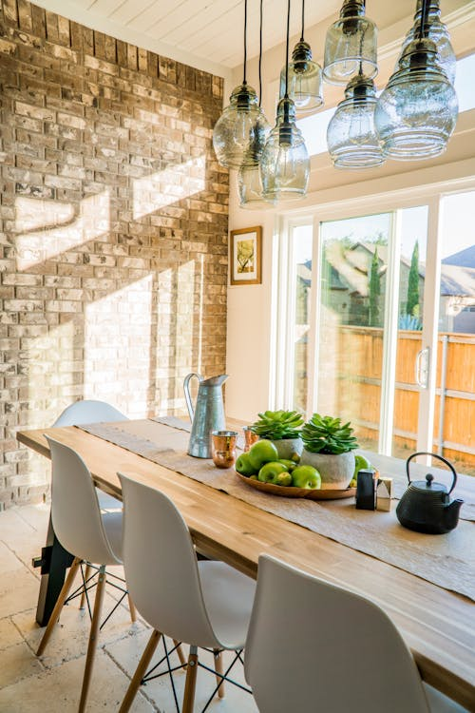
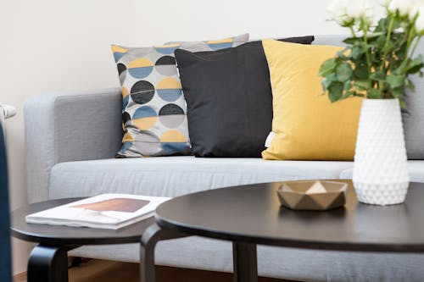
Furniture/ Items
Good repair
Safe
Used for Intended Purpose

Slide 29
Walls / Ceilings / Flooring
Free from holes and large stains
Free from trip hazards
Free from excessive wear
Power strips and extension cords are used appropriately
Window coverings are appropriate
Switches, light bulbs, outlets have appropriate covers
No excess wires hanging from walls or ceilings

Slide 30
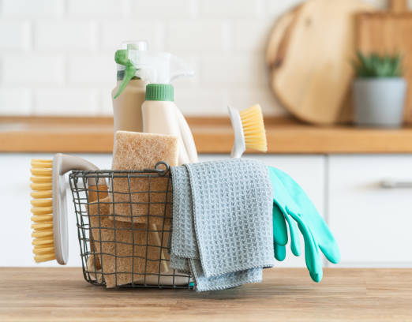
Cleanliness
Free from excessive dirt, clutter
No Broken appliances, furniture and other items
No visible signs of pests
Food is stored appropriately, not in resident bedrooms or places where pests can get at it

Slide 31
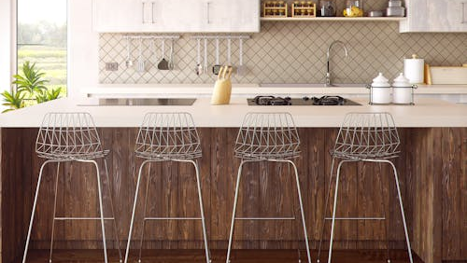
Kitchen
Fire extinguisher
One fridge for every five residents
No food stored on the floor or other inappropriate places
Dishes are clean and stored appropriately
Cabinets are in good repair
Refrigerator in good working order
Stove in good working order
Oven is in good working order
No other appliances are required, but if they are in the kitchen, they should be in good working order
Supplies to wash hands

Slide 32
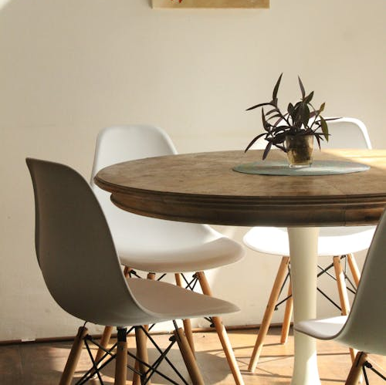
Dining Area
Large enough for residents to share a meal together
Furnished with a table and chairs

Slide 33
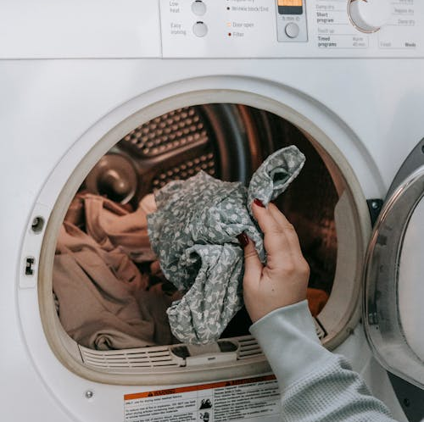
Laundry
Washer and Dryer in good working order
OR
- Accessible laundromat (residents can get there and it is affordable)

Slide 34
Basements
Not required to have a basement but if there is one -
Free from standing water
Free from excessive clutter and debris
If basement is used for storage, it is should be neat and not present safety or trip hazards

Slide 35
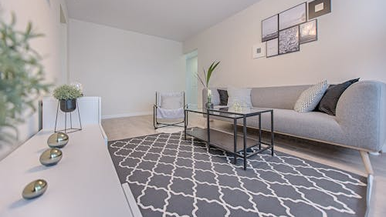
Living Room/ Common Areas
Large enough for residents to gather for formal or informal gatherings
Free from clutter, dirt, debris
Furnished so residents can have a seat

Slide 36
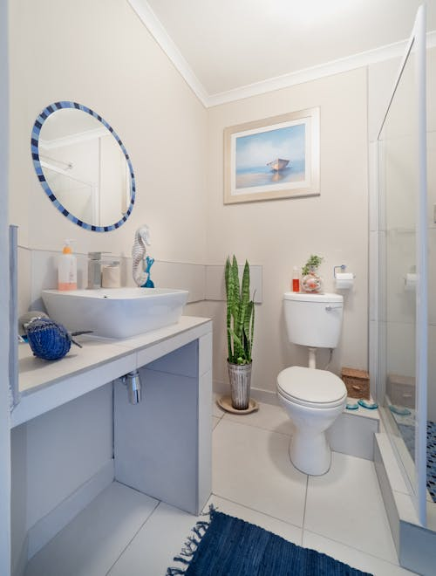
Bathrooms
One toilet, sink and shower per six residents
Must be in good working condition
Bathroom has a door
Shower has appropriate door or curtain
Need to be clean, free from mold, dirt and clutter
Toilet paper
Supplies to wash hands
Any windows have covers for privacy
Bathroom is appropriately finished

Slide 37
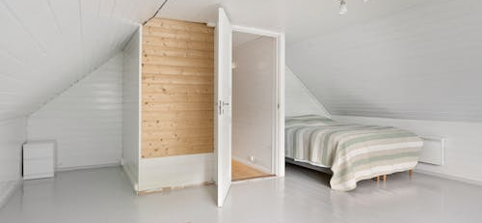
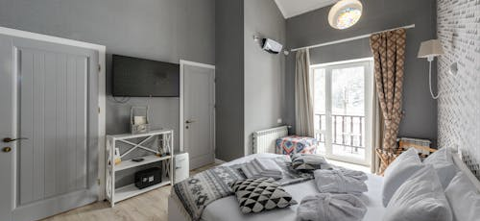
Bedrooms
Has a door
70 square feet for one, 120 square feet for double
Each resident has a bed
Appropriate egress
No fridges in bedrooms
No food in bedrooms
Fire detector in bedroom
Storage – folded clothes, hanging clothes for each resident

Slide 38
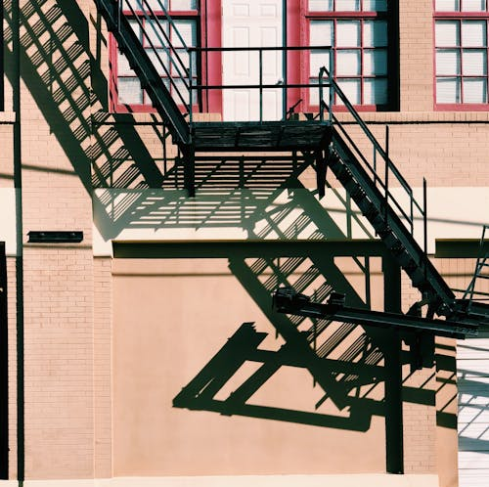
What is an appropriate secondary egress
Typically, this is a window that opens
If you do not have such, check with your local fire department

Slide 39
If we ask you where the egress is and you do not know, it will be an issue

Slide 40
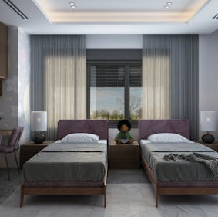
Rooms with more than two residents
Need 50 additional square feet per resident
Must have homelike elements
Residents can arrange furniture
Residents have a reasonable ability to decorate the space
Furniture is homelike
Privacy options are offered (through screens or room arrangement)

Slide 41
No room may have more than six residents

Slide 42
Questions

Slide 43
Cameras
Cameras are NOT required

Slide 44
Cameras can be used on the exterior

Slide 45
Interior Cameras
NOT required but if you do have them…
No cameras in bathrooms, bedrooms or other areas where residents expect privacy
Must have a written policy regarding cameras

Slide 46
Interior Cameras
Cameras are not used to replace staff
Not monitored constantly, but footage only viewed if there is an issue
Residents know where cameras are placed
Able to record who views footage and when
Only authorized people have access
System in place to ensure only authorized people are viewing footage for approved reasons

Slide 47
Example
Appropriate use of cameras
A resident believes that their laptop was stolen from the common room. The resident brings this to the house manager. The house manager informs the program director, who has the ability to use the fees. The program director views the footage from the day in question to see if the laptop was stolen.
Inappropriate use of cameras
Instead of stopping by the home in person, a house manager pulls up footage from the recovery home to see if there is anything concerning going on at the home.

Slide 48
Questions

Slide 49
Funding for Physical Property Repairs
If you have items that need repaired AFTER your property review
You can apply for funds to repair those items
Open to new and certified operators
Up to $10,000 per address, $30,000 per organization
If you lease the property, you can only apply for funds for items that are NOT fixed to the property
More details on our website

Slide 50
Final Questions
Danielle@ohiorecoveryhousing.org
614-453-5133

