Slide 1
Financial Landscape of Recovery Housing: Results from a National Survey
Prepared by the RCORP-Rural Center of Excellence on SUD Recovery at the Fletcher Group
Ohio Recovery Housing 2025 Annual Conference
Notes:
Hi everyone! Today I’m going to be discuss the results of a national study our Fletcher Group research team has been conducting examining the financial landscape of recovery housing.

Slide 2
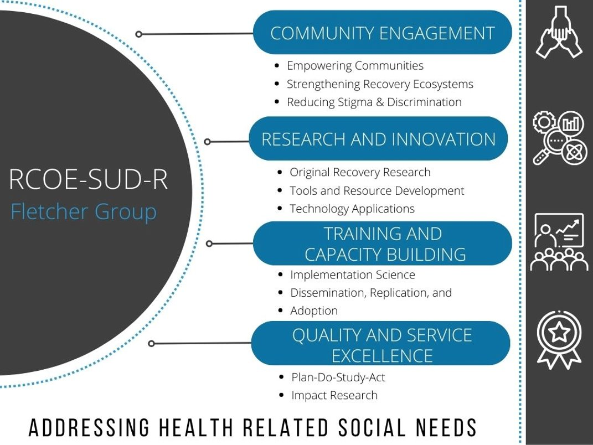
Rural Center of Excellence
Notes:
Intro to who you are/who the fletcher group is

Slide 3
Why did we conduct this study?
Many unknowns exist about the recovery housing industry as a whole including:
Cost to run a recovery housing program
Expense categories
Most common revenue sources
Financial needs of recovery housing organizations
Financial resilience of recovery housing organizations
Understanding the costs associated with recovery housing and the specific funding needs is essential to inform policy and support operators.
Notes:
The initiative we’re going to be discussing today arose from a technical assistance request from the NARR affiliate down in West Virginia. They were struggling to talk with state legislators about recovery housing as a lot of legislators had a misconception that recovery housing was a great way to make tons of money. They had no real idea about the financial realities of operating recovery housing. After some research around the financing and financial operations of recovery housing, we realized that there was no data that really existed around the topic that could be used to help address these concerns. We found specific unknowns related to costs to run a recovery housing programs, what the expense categories are when running a home, where the revenue for operation generally comes from, and the financial needs and resilience of recovery housing organizations. We know that understanding the costs associated with recovery housing and the funding needs of operators is essential to inform policy and support operators.

Slide 4
Study Purpose and Methods
Study was designed to inform financial planning and expansion efforts of recovery housing organizations by assessing
Financial size of recovery residences
Revenue sources
Operating expenditures
Financial resiliency
Barrier to continued operation
To date, study has been conducted in 18 states in collaboration with NARR state affiliates
Survey was disseminated via emailed invitation to certified houses in 18 states.
Participating organizations had the opportunity to receive a Fletcher Group Economic Calculator Report.
Notes:
So, in response to this technical assistance request we developed a survey to help us get some data on all of those unknown. The goal of the survey was to inform financial planning and expansion efforts of recovery housing organizations by assessing the financial size of the organizations, what those revenue sources are, what the operating costs are, how financially resilient the organization is, and importantly, what the barriers are in terms of funding and in general to continued operation and expansion.
This is a national study that has been conducted in 18 states with the collaboration of the NARR state affiliates. So, in the results I’ll be discussing here shortly, we’ll examine mostly the results relating to the Ohio recovery houses, but I’ll also bring in some ties to the national data and discuss key spots where Ohio recovery housing organizations differ from other recovery housing organizations.
The survey was disseminated in states mostly to NARR-certified recovery houses but in some states we did include non-certified houses. As a give back to operators for taking the time to complete a very exciting survey about organizational finances, we offered operators access to our Fletcher Group Economic Calculator and they could receive a customized report detailing the economic impact of their organization. In most states we were able to take all of the economic characteristics and also provide a statewide economic impact report as well.

Slide 5
Sample Overview - Ohio
Characteristics of recovery residences surveyed, Ohio, 2024, (N = 288)
NARR Certification Level | Count (%)
Level 1 | 40 (14)
Level 2 | 172 (60)
Level 3 | 47 (16)
Level 4 | 0 (0)
Not ORH Certified | 22 (8)
Unknown/Missing | 7 (4)
Geographic Location | Count (%)
Rural | 85 (30)
Urban | 106 (37)
Suburban | 82 (29)
Missing | 15 (5)
Residence Ownership | Count (%)
Rent | 93 (32)
Own | 187 (65)
Missing | 8 (3)
Sampling pool included all ORH certified organizations (N = 130).
81 organizations representing 288 residences responded
62% response rate
Key organizational characteristics:
65% operate multiple residences
96% support MAT
58% turn away residents due to lack of capacity
Notes:
Alright, so let’s get into it. So, in Ohio we focused on organizations that were certified by ORH which was 130 organizations at the time we ran the study. We got a total of 81 organizations to respond to the survey that represented 288 residences. That puts our response rate at 62% which was one of the highest response rates across all of the states we conducted the study in. So, if you are an operator that took the time to take our survey, thank you so much!
Some key organizational characteristics of the sample. First, we found that most organizations operate more than one residence and almost all of the organizations support medication assisted treatment. We also found that over half of the organizations had to turn away residents due to a lack of capacity in the past few months. While a lot of states reported a lack of capacity, Ohio did rank quite high among the states in a lack of capacity.
Looking at the characteristics of the 288 residences, we see that the majority are certified as level 2 homes. About 15% of the houses are certified as level 1 or 3 and then none of the homes in the sample are certified at level 4. We also see a pretty even geographic spread with 30-37% of homes being in rural, urban, and suburban areas. Finally, we do see that most residences are owned rather than rented. Ohio does have a higher share of residences owned compared to some other states we’ve collected data in. Specifically, states with much more expensive housing markets like Colorado and Washington.

Slide 6
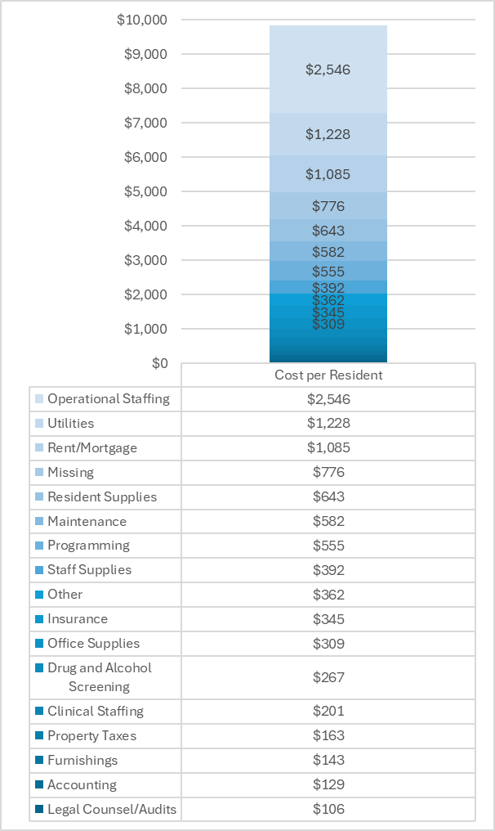
Annual Operating Costs -Ohio
Median annual operating cost: $140,000 (National = $169,000)
Ranged from $10,000 to $2.4 million
Median amount spent per resident served annually: $9,800 (National = $6,700)
Per resident cost for orgs that operated multiple residences: $9,400
Per resident cost for orgs that operated one residence: $11,300
Notes:
Next we can look at annual operating costs for Ohio recovery housing organizations. The median annual operating cost was $140,000, with operating costs ranging from $10,000 to $2.4 million per year.
Larger operating costs were generally associated with organizations that operate multiple homes, with organizations that operate multiple homes having a median annual operating cost of $181,000, compared to a median annual operating cost of $95,000 for organizations operating a single home. For organizations operating multiple residences, the median operating cost per home was almost $50,000.
Operating costs also differed by the level of services provided within the organizations. Organizations that operated only level 1 certified residences (N = 3) had a median operating cost of $46,000, whereas organizations that operated only level 2 certified residences (N =35) had a median operating cost of $120,000 and organizations that operated only level 3 certified residences (N = 4) had a median operating cost of $254,000.
Operating costs also varied significantly depending on how many residents were served. Organizations that served 20 residents or less (N = 39) had a median annual operating cost of $120,000, while organizations that served between 21 and 50 residents (N = 12) had a median annual operating cost of $204,000. Organizations that served 51 residents or more (N = 4) had a median annual operating cost of $558,000.
The median amount spent by organizations was approximately $9,800 per resident served annually. The amount spent per resident differs by whether the recovery housing organization operates multiple residences. Organizations that operate multiple residences spent a median of $9,400 per resident annually while organizations operating only one residence spent a median of about $11,300 per resident annually.
The annual cost per resident served also differed by the level of services provided within the organizations. Organizations that operated only level 1 certified residences (N = 3) had an average cost per resident of $8,000, whereas organizations that operated only level 2 certified residences (N =31) had an average cost per resident of $11,000 and organizations that operated only level 3 certified residences (N = 4) had an average cost per resident of $13,900.
Operating costs associated with room and board such as staffing, mortgages/rent, utilities, maintenance, insurance, property taxes, accounting, legal counsel and audits, and furnishings accounted for 66% of total operating costs (approximately $6,489 per resident served). Operational staffing accounted for the largest share of operating costs (26%), followed by mortgage/rent (22%), utilities (13%), maintenance (6%), insurance (4%), clinical staffing (2%), property taxes (2%), furnishings (1%), accounting (1%), and legal counsel and audits (1%). Service costs including costs incurred from programming, resident and staff supplies, and drug and alcohol screening accounted for 22% of operating costs (approximately $2,163 per resident served). Programming costs accounted for approximately 6% of operating costs, and a relatively small amount of operating costs were spent on resident supplies (7%), staff supplies (4%), and drug and alcohol screenings (3%). A negligible amount of operating costs (<1%) were reported to have been spent on childcare, diapers, and Naloxone.

Slide 7
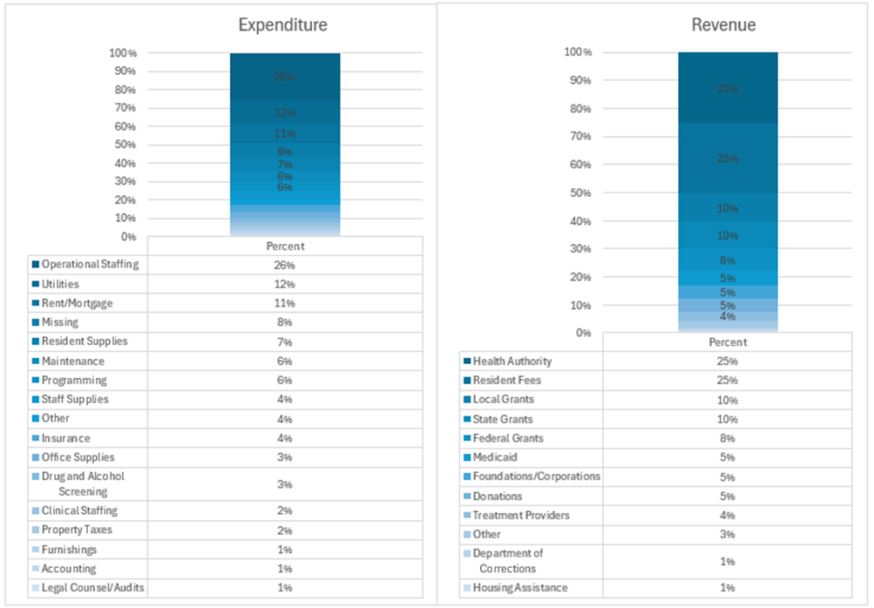
Revenue Sources and Expenditures
Figure. Percent of annual revenue from different sources and percent of annual expenditures associated with different categories reported by Ohio recovery residence operators, 2024, (N = 67)
Notes:
In terms of revenue sources, the largest share of revenue comes from contracts with local County Behavioral Health Authorities (25%) and resident fees (25%). Of those who disclosed the amount they charge in resident fees (N = 70), the average amount charged was $411 per month, with some organizations charging as little as $0 per month and some as much as $1,560 per month. Organizations indicated they only received about 75% of the resident fees they charge. Additionally, only 21% of organizations indicated they dismissed residents who were unable to pay for resident fees.
Local and state grants accounted for the third and fourth largest source of revenue with organizations indicating that an average of 10% of revenue came from local and state grants. Of those who indicated they had received local or state grants (N = 28), 7% indicated they had received State Targeted Response Funds, 43% indicated they received State Opioid Response funds, 7% indicated they had received Substance Abuse Prevention and Treatment Block Grants, and 14% indicated they had received State Recovery Housing Initiative Funds.
Federal grants accounted for 8% of revenue and Medicaid, foundations and corporations, and donations accounted for 5% respectively. Finally, organizations indicated that an average of 4% of their revenue came from contracts with treatment providers and 1% of revenue came from contracts with the Department of Corrections and Housing Assistance funds.

Slide 8
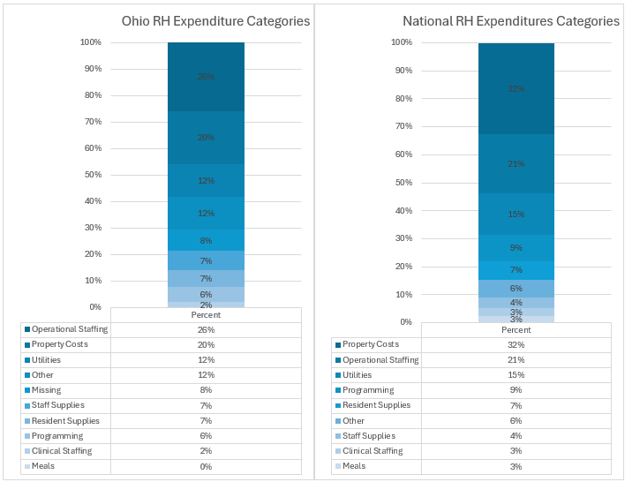
Operating Costs: National Comparisons
Ohio
Operational staffing, property costs, and utilities make up majority of expenses
Ohio RH spends a small proportion of operating costs on property costs and more on operational staffing
Notes:
Next we can compare the operating cost categories for Ohio recovery housing organizations and the national sample. Generally, operational expenditures are similar nationally and in Ohio. Operational staffing, property costs, and utilities make up majority of expenses. Ohio RH spends a small proportion of operating costs on property costs and more on operational staffing

Slide 9
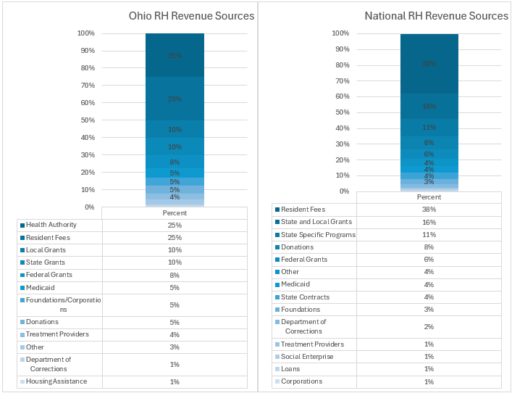
Revenue Sources: National Comparison
Ohio
Health authority, resident fees, and local grant make up the majority of revenue
State specific programs make up a larger percentage of revenue for Ohio RH than the national average
Ohio RH relies less on resident fees than the national average
National
Resident fees, local and state grants, and state specific programs make up the majority of revenue.
Notes:
Looking at revenue sources of Ohio recovery houses and the national sample we see some important differences. For Ohio recovery houses, the Health authority, resident fees, and local grant make up the majority of revenue. State specific programs make up a larger percentage of revenue for Ohio RH than the national average and Ohio RH relies less on resident fees than the national average.

Slide 10
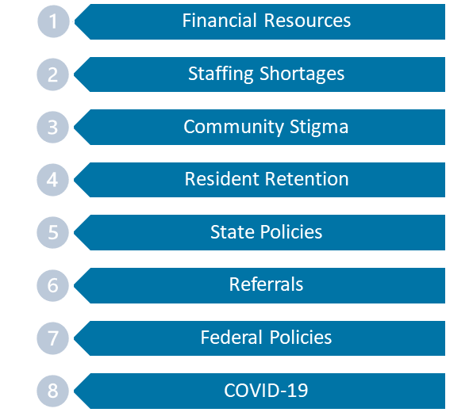
Financial Resiliency
Ranking of challenges to continued operation with 1 representing the most significant barrier and 8 representing the least significant challenge (N = 66).
62% of organizations indicated “financial resources” were the most significant barrier their program faced.
On a scale from 1 to 10, programs ranked their financial resilience at 6.2 on average.
52% of recovery housing programs surveyed indicated they received 75% or more of their revenue from one source
Notes:
Next, we examined barriers to operation for Ohio recovery houses and financial resiliency.
among a list of 8 challenges to continued operations, the challenge that was ranked highest that impacted continued operation was a lack of financial resources. Of the 66 organizations that responded to this question, 62% indicated it was the most significant barrier their program faced. The next largest challenge identified was staffing shortages, followed by community stigma. Resident retention was identified as the 4th greatest challenge to continued operation, followed by state policies. Referrals, federal policies, and COVID-19 were identified as some of the least significant challenges faced by owners and operators.
To assess the financial resilience of recovery housing organizations in Ohio, owners and operators were asked to rank on a scale of 1 to 10 how financially resilient they felt their recovery housing program was, with higher scores indicating higher resiliency. On average, organizations ranked their resilience at 6.2, indicating a relatively moderate level of financial resiliency.
Over half of the organizations surveyed (66%) indicated they were slightly or moderately capable of overcoming funding disruptions and 22% indicated they were very or extremely capable of overcoming funding disruptions. However, 12% indicated they were not at all capable of overcoming funding disruptions. Revenue diversification is also key to financial resilience. Over half (52%) of recovery housing organizations surveyed indicated they received 75% or more of their revenue from one source.

Slide 11
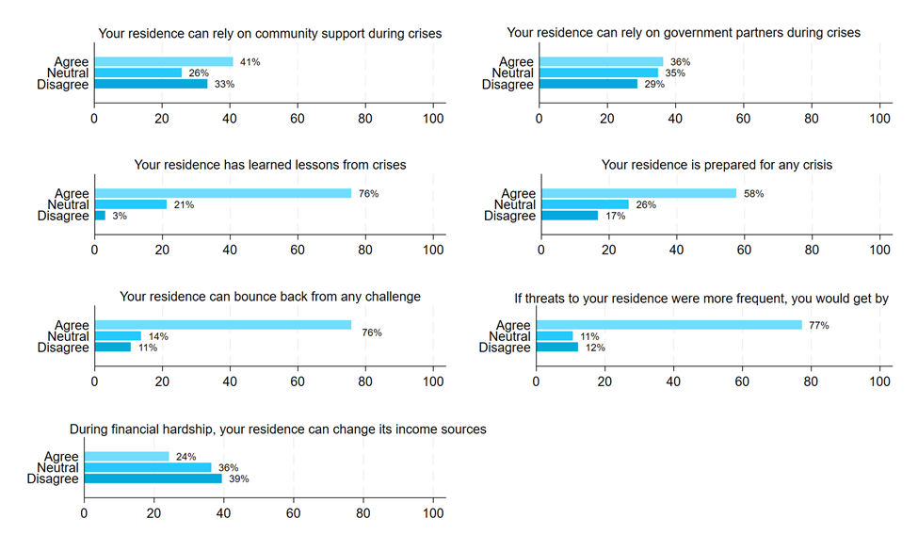
Financial Resiliency
Highlights:
Perceived lack of community support and government partner support
Strong perception of resilience and ability to learn from experience
Notes:
A series of questions were asked to ascertain operators’ perceived ability to overcome financial crises, how community and government partnerships could help them overcome such crises, and if they had learned lessons from prior financial crises. Reflecting the barrier of community stigma discussed in the previous section, only 41% of organizations agreed that they could rely on their community for support during financial crises while 33% disagreed (Figure 4). Recovery housing organizations also indicated a lack of perceived government support during financial crises, with only 36% agreeing that they could rely on government partners during crises and 29% disagreeing. A total of 76% indicated that their recovery housing program has learned lessons from crises and 76% agreed that their residence can bounce back from any challenge. Similarly, 77% agreed that they would be able to get by if threats to their program were more frequent. Only 58% agreed that their organization is prepared for any crisis and only 24% agreed that their organization can change its income sources during financial hardships.

Slide 12
Barriers related to Grants
Programs that had received grants of any kind (N = 29) reported an average of 11 hours spent per month finding and applying for grants.
59% of programs indicated that it was somewhat or extremely difficult to find grants
31% indicated it was somewhat or extremely difficult to apply for grants.
Specific barriers related to grants included:
Grants are limited to projects and don’t include operations
The grant process is difficult to navigate
Limited opportunities for new providers.
“Most grants do not cover operational costs for recovery housing”
“Because I’m not familiar with that area and we can’t afford to hire someone to write the grants for us”
“we are relatively new housing and grantors want 3-year track records”
Notes:
While lack of financial resources is a multi-faceted issue, difficulties finding and applying for grants may compound this barrier. Of organizations that had received grants of any kind (N = 29), they reported an average of 11 hours per month spent finding and applying for grants. Further, 59% of organizations indicated that it was somewhat or extremely difficult to find grants and 31% indicated it was somewhat or extremely difficult to apply for grants. Approximately 24% of organizations indicated it was somewhat or extremely difficult to comply with the terms of the grants they receive.
Common barriers related to grants included that grants are limited to projects and don’t always include operational expenses. Additionally, operators noted that the grant process itself was difficult and time consuming to navigate. Finally, operators noted there were few opportunities for new providers.

Slide 13
Recovery Housing Financial Needs
Operators noted need for more funding opportunities in general
“Our current funding streams cover the bare minimum. We would be able to provide an array of additional services if there were more funding streams available and consistent renewals”
Operators having funding needs specifically related to rental assistance, food, and resident supplies.
“more funding opportunities are needed for rental assistance food and home improvements. financial assistance is needed for clothing and toiletries”
Operators noted need for both capital funding and operational funding.
“One of the most significant issues we continue to deal with is the lack of being able to access programs like tax credits for capital dollars”
“We need more funding for operational costs. Most grants do not look at the house itself as being a significant part of recovery programs”
Operators also have difficulties with short-term grants.
“Every year we are on edge about the funding being cut, or redirected to other areas. At the end of each funding period it is a very stressful time. Grant writers are very expensive”
Notes:
In the survey, we also asked operators to tell us what financial needs their recovery housing organization had. A couple of themes emerged from that write in data. First, operators noted the need for more funding opportunities in general, with many noting that their current revenue barely covered operating costs. Additionally, operators noted the need for more funding to cover rental assistance, food, and resident supplies. Operators noted the need for both capital funding to support the expansion of their operations and operational funding to cover the everyday costs of running their program. Finally, oeprators noted their difficulties with short term grants, noting the difficulty with planning with one or two year grants and the costs associated with engaging in the grant process.

Slide 14
Economic Impact of Certified Ohio Recovery Housing Organizations
Variable | Output
Total Residents Served | 151,065
Total Benefits | $37,515,988,738
Total Costs | $625,555,252
Net Benefits | $36,890,433,485
Return on Investment | $58.97
Using data from the financial landscape study, we use the Fletcher Group Economic Calculator to calculate the total economic impact of ORH certified organizations over 15 years.
Annual amount spent on operating costs = $51,383,687
Total amount spent on start up costs = $34,591,440
Number of residents served annually = 10,071
Notes:
As I mentioned at the beginning of the presentation, we were able to look at the economic impact of all certified Ohio Recovery Housing organizations as part of this study.
The Fletcher Group Economic calculator tool quantifies economic benefits associated with recovery including associated with reduced healthcare, criminal justice, and productivity costs, as well as benefits associated with reduced morbidity and premature mortality (i.e., saving lives). In terms of costs, the tool focuses on the operating costs and start-up or capital costs of the recovery organization.
Looking at the aggregate data of all Ohio recovery housing organizations, we found that they spend approximately $51.4 million annually on operating costs, 34.6 million on start up costs, and serve approximately 10,000 residents annually. With these characteristics, we estimated the total economic impact over 15 years.
Over the course of 15 years, ORH-certified recovery housing organizations serve approximately 151,065 residents. The total present value of economic benefits for all organizations is approximately $37.52 billion. The present value of total costs is approximately $626 million. The present value of the net benefits (i.e., the total benefits minus the total costs) is approximately $36.89 billion over 15 years. The total return on investment of the organizations over the course of 15 years is $59 dollars per dollar invested.

Slide 15
Policy Considerations - Funding
Increase the funding available to recovery housing organizations including funding for capital expenditures, initial start-up expenses, and programmatic operating expenditures.
Develop long-term (more than one year), sustainable funding opportunities for certified recovery residences.
Provide education and training to facilitate easier access to state grants and understanding of the grant application process; potentially a designated grant specialists at the state supporting recovery providers.
Develop an individual level voucher program for recovery housing residents such that funding support follows residents throughout their engagement in recovery support services and can be transferable between certified recovery housing residences.

Slide 16
Additional Policy Considerations
Increase the capacity of certified recovery residences that can provide appropriate services to populations, including pregnant and parenting people, families, veterans.
Cultivate new relationships and reinforce current relationships among recovery housing organizations and other recovery support providers along the SUD continuum of care with a specific focus on breaking down barriers to sustainable and meaningful partnerships.
Provide training and resources to recovery housing organizations to encourage community partnerships, to reduce stigma, and increase community support.
Conduct another assessment of the recovery housing financial landscape study in the future that includes additional financial incentives to program operators to increase study engagement.

Slide 17
Rural Recovery House Best Practices ~ over 30 areas ~
Start a Recovery House
Social Model/Blended Model
Recovery House Management
Re-entry
Overcoming Stigma/NIMBY
Building Recovery Ecosystems
Outcomes
Community Engagement
Sustainability/Funding
Community Organizations
OUD/MOUD
Strategic Planning
Recovery House Budgeting
Social Model Training
Workforce Development
Recovery House Staffing
Over 3,000 TA encounters, to 667 clients & organizations, in 35 States!

Slide 18
Economic Calculator
Cost Benefit Analysis
Recovery Houses & RCO’s
Grant Applications
Advocacy
Outcomes

Slide 19
Employment Coach Training
Meaningful Employment
Identify interests
Expand skill sets
Partner with local employers
Discover new funding
Build financial stability
Experience expert coaching

Slide 20
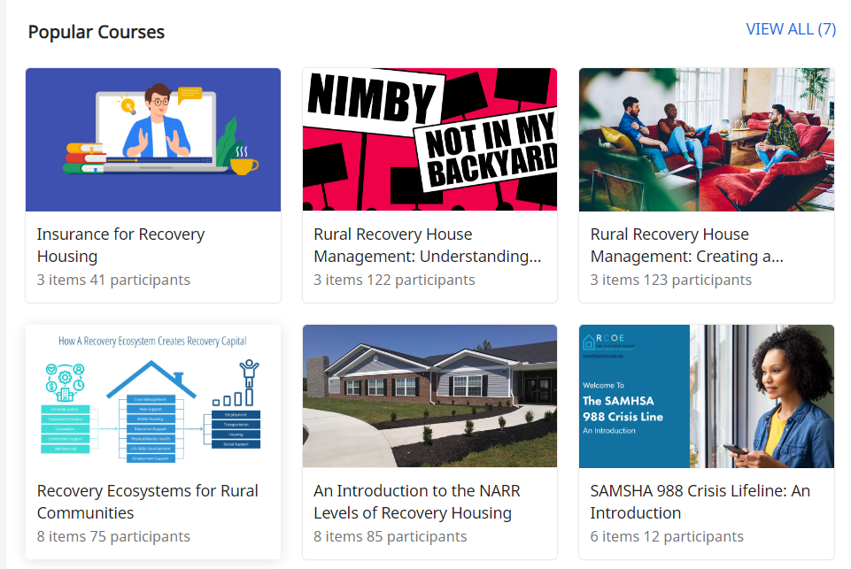
Online Learning Center

Slide 21
Life Skills Training
By SMART Recovery
No-Cost to you!
$1200 stipend
Virtual classes
Live Instruction
Facilitator Training
No obligation

Slide 22
Monthly Webinar Series
Past Topics
Grant Writing
Chronic Nature of Addiction
Marketing
ASAM 4th Edition Updates
Coming up
Revenue Strategies for Nonprofits

Slide 23
RCORP – Rural Center of Excellence on SUD Treatment
RCORP – Rural Center of Excellence on SUD Prevention
RCORP – Rural Center of Excellence on SUD Recovery
Find us at:
www.uvmcora.org
Find us at:
recoverycenterofexcellence.org
Find us at:
www.fletchergroup.org
This presentation is supported by the Health Resources and Services Administration (HRSA) of the U.S. Department of Health and Human Services (HHS) as part of an award with zero percentage financed with non-governmental sources. The contents are those of the author(s) and do not necessarily represent the official views of, nor an endorsement by, HRSA, HHS or the U.S. Government.
Notes:
[Standard slide about the three centers that was developed jointly.]

Slide 24
Thank you!
mashworth@fletchergroup.org
Madison Ashworth, PhD
Health Economist
rnichols@fletchergroup.org
Rachael Nichols
Outreach and Engagement Specialist
This presentation is supported by the Health Resources and Services Administration (HRSA) of the U.S. Department of Health and Human Services (HHS) as part of an award totaling $3.3 million with 0% financed with non-governmental sources. The contents are those of the author(s) and do not necessarily represent the official views of, nor an endorsement, by HRSA, HHS, or the U.S. Government.

