Slide 1
From Data to Impact: Building the Case for Quality Recovery Housing
ORH 2025 Annual Conference
Presented by Gretchen Clark Hammond, PhD, MSW, LSW, LCDCIII, TTS
CEO, Mighty Crow

Slide 2
Hey, Friends!
Mighty Crow launched in 2012. We work across Ohio and with clients in other states.
As a company, we are pride ourselves on being resolute, providing expertise, being ingenious, and generous.
We have professionals spanning the fields of social work, finance, information technology, pharmacy, communications, data science, and city and regional planning.
We are fortunate to have worked alongside ORH since they first launched in 2014.

Slide 3
Meet Your Speaker
Dr. Gretchen Clark Hammond has:
26 Years experience in the Behavioral Health field
Owned and operated Mighty Crow for 13 years
Been published over 15 times
Attended every ORH Conference
(And spoken at most of them)
Completed over 700 workouts at Fitness Evolution
Seen The Arkells 6 times in the last 2 years
(Thinks you should go see them too!)

Slide 4
Let’s Have Some Fun
CONFERENCE COUNTDOWN
Everyone please stand (if you are able).
THIS IS MY...
First ORH Conference
Second ORH Conference
Third ORH Conference
Fourth ORH Conference
Fifth ORH Conference
More than five?
Were you there at the beginning?!

Slide 5
First Conference
In October 2013, Ohio hosted our first statewide training on recovery housing
Over 130 guests attended the two-day event.
The event was co-hosted by Ohio Mental Health & Addiction Services (OhioMHAS), the Ohio Council, OARRS, and the Coalition on Housing and Homelessness in Ohio (COHHIO).

Slide 6
Second Conference
In September 2014, OhioMHAS co-hosted Ohio’s 2nd Recovery Housing Conference along with the Ohio Council and COHHIO.
Over 150 people attended the two-day event
Deputy Director David Mineta of the White House Office of National Drug Control Policy presented on Federal policy trends
Jason Howell, President of the National Alliance for Recovery Residences (NARR) shared national best practices
Provider, housing and board collaborations that are working in Ohio were highlighted
A legislative overview on recovery initiatives in the Ohio legislature was provided by Representative Lynn Wachtmann, Ohio House of Representatives
Director Plouck provided an overview of accomplishments with Ohio’s recovery housing initiative to date.

Slide 7
Fast Forward to Today

Slide 8
Learning Objectives
We want you to:
Understand foundational principles for accurate and timely data collection as it relates to the ORH Outcomes Tool
Understand how to interpret data trends over time from move-in, six-months, and exit from recovery housing
Learn how to share data in ways that help stakeholders understand the impact of recovery housing

Slide 9
Let’s think for a minute...
How do we successfully harness data to tell the story of the successes and benefits found in recovery housing?
What is the life cycle of data and outcomes reporting?
What are some best practices for data collection?
How do I know what I should be looking for and how to interpret the information?
How do I use my findings to help advocate for recovery housing?

Slide 10
Now, let’s go back in time… and consider data

Slide 11
The founders and early leaders of ORH knew:
The power of data and the value of telling the story of recovery housing
That if they didn’t find a way to start telling the story of recovery housing, that someone else would…
...and that might not be ideal

Slide 12
Sharing the Big Picture
Environmental Scan of Recovery Housing (v.1) is completed
Environmental Scan of Recovery Housing (v.2) is completed
Mapping the Gap: An Assessment of Capacity, Cost-Benefits, and Disparities in Utilization in Ohio Recovery Housing
2015
2022
2013
2021
2023
ORH Info Sheets Released:
Residents
Policy Makers
Treatment Providers
Community
ORH DEI Analysis Report Completed

Slide 13
11 years of outcomes
Building
Data Science
3
Application of Machine Learning to ORH Data
Building and Testing the Tool; Adding Data Dashboard
8
Launch 1.0
Publications
2023-2024
6
2015-2016
2
Tool goes live! Data Collection and Reporting begins.
Telling the Story and Sharing Knowledge
1
Planning
March 2016
2024-2025
Meeting with Board, Literature Review
7
4
Launch 2.0
Rhoads construction
Oct. 2014-August 2015
Update
Updated ORH Outcomes Tool and Dashboard
Updating questions; privacy review; dashboard update
RH Operator and Affiliate Data System
May 2022
5
2021-2022
Began 8/2023

Slide 14
We have a way to collect data and tell our story!
Please understand how fortunate we are to have a standardized way of collecting data across operators in Ohio – this situation is rare. It allows us to tell a very detailed and powerful story about recovery housing in Ohio. And…it’s a system that all operators can access!
What has allowed this system to grow since 2016 are the use of some foundational principles for accurate and timely data collection.

Slide 15
History of the ORH Outcomes Data
2014
Prior to 2014, there was no funding in the state budget for recovery housing. It was only through advocacy and data that this funding stream was created.
There was also no organization that had a sole focus on recovery housing. The establishment of ORH was essential to the growth of the field and essential to the needs of recovery housing providers to be heard.
Mar. 2016
Outcomes Tool Launches
ORH worked closely with the ORH Board, staff, operators, and the team at Mighty Crow to develop a web-based survey and data dashboard.
Between March 2016 and April 2022, over 11,500 surveys were submitted.
2021
After 5 years of use, an assessment of the Outcomes Tool was done
We looked at what data points were most useful, what additional data we wanted to be collecting, and what changes could be made to increase data clarity and accessibility for operators.
Technical upgrades were made to allow more users (such as county boards) access to the data.
May 2022
Outcomes Tool 2.0 Launches
The outcomes survey and data dashboard were re-launched. The user experience remained much the same, but now with higher quality data collection and display options.
August 2024
20,000 surveys have been submitted to the new tool, for a total of 31,000+ surveys since ORH began collecting data

Slide 16
History of Data Analysis
2016 – Present: Real-time dashboard data
2016-2020 Combined analysis
2021 – 2023 Annual analyses of survey data
2023: Mapping the Gap: An Assessment of Capacity, Cost-Benefits, and Disparities in Utilization in Ohio Recovery Housing
2023: Understanding trends across population segments
2024: Descriptive Review of Outcomes According to Housing Level

Slide 17
Data Quality
Accuracy
Completeness
Reliability
Timeliness
Relevance

Slide 18
Accuracy
Are we focused on our data being correct?
we care because accurate data is tied to reliability
inaccurate data can lead to misinformation
In our outcomes tool, we are asking residents to provide responses to a series of questions. Data accuracy in self-report measures refers to how closely the reported information aligns with reality or truth, which can be influenced by many factors including memory or a concern about what others think.
Are the questions are designed to be straightforward and understandable?
Our questions were informed by the founding members of the ORH Board and have been reviewed regularly.
However, when a resident sits down to complete the outcomes tool, you should tell them to ask you to help explain any questions that are confusing.
Not understanding a question can lead to an inaccurate response.

Slide 19
Improving Accuracy
Use clear, unambiguous language when designing the tool (we’ve done this)
1
Ensure participants that their responses are confidential (we don’t collect identifying information on them)
2

Slide 20
Completeness
Are there missing data?
Did the resident answer all the questions?

Slide 21
Reliability
Is our data reliable?
this includes following the set time periods, using the correct version of the instrument, etc.
How can we improve consistency?
by training our staff on the processes for data collection
by standardizing our processes for how we collect data
By using the tools and technologies available to us

Slide 22
Relevancy
Is the data that is gathered is suitable for the research question being asked?
Are we collecting data that provides context to the issue at hand?

Slide 23
Timeliness
Are we collecting, processing, and delivering data efficiently?
How often data is collected?
Is it at the correct time intervals?
How do we resolve any technical or process issues that may be causing delays?

Slide 25
Implications
Data gives us an understanding of our residents at given points in time – this means a couple of things:
It gives us insight into the present, as well as into the future
It reminds us that things can change over time as well
As the sample size grows, we may also learn different things about our residents
And…a good study always inspires us to want to know more

Slide 26
Recovery Housing plays a valuable role in improving outcomes for residents

Slide 27
SAMHSA

Slide 28
HOME is where Recovery Lives
“Recovery housing can be a critical asset in supporting an individual on their journey of recovery.” - SAMHSA Best Practices for Recovery Housing, p.1
“Recovery housing provides residents a stable and safe place to live. Persons with substance use issues often return from treatment and institutions to living environments that enable addictive lifestyles. Secure housing is an important component of recovery and has proven to promote successful recovery outcomes (Lo Sasso et al., 2012).” p. 4

Slide 29
Evaluation in the Real World
In 2023, I co-authored a book chapter titled, “Evaluation in the Real World” to recognize that it is a formidable task that is often influenced by the realities of changing policies, mandates, funding streams, leadership, and unforeseen events.
We know we need to study what we are doing so that we can understand if our interventions are making a difference, are relevant to the people we serve, and so that we can continue to grow in our knowledge for the future.

Slide 30
Laboratory Experiments

Slide 31
What is Evaluation?
The American Evaluation Association defines evaluation as a process of assessing and assigning value to a program or practice (Stufflebeam, 2001; Wanzer, 2021).
Evaluation can also be viewed as a means of learning about how a program is operating and how to improve it (Nestor Feinstein, 2012; Scheirer, 2012).
There are types of evaluation as well:
Formative of Process Evaluation: takes place during a program’s implementation to determine how effectively it is being carried out and discover areas for refinement before the program has ended (Hatry, 2013; Stufflebeam, 2001).
Summative or Impact Evaluation takes place at the end of a grant cycle or program year, to determine the outcomes of the activities or interventions that were implemented (Hatry, 2013).

Slide 32
Types of Data
There are two broad categories of data that we collect: quantitative and qualitative:
Quantitative is usually numbers or statistical information
Qualitative is usually words, pictures, and other ways to gather contextual and descriptive information
Evaluations that combine the collective of both types of data are known as mixed methods designs
Both types of data are valuable in giving us a more complete picture

Slide 33
Quantitative Data

Slide 34
Qualitative Data

Slide 35
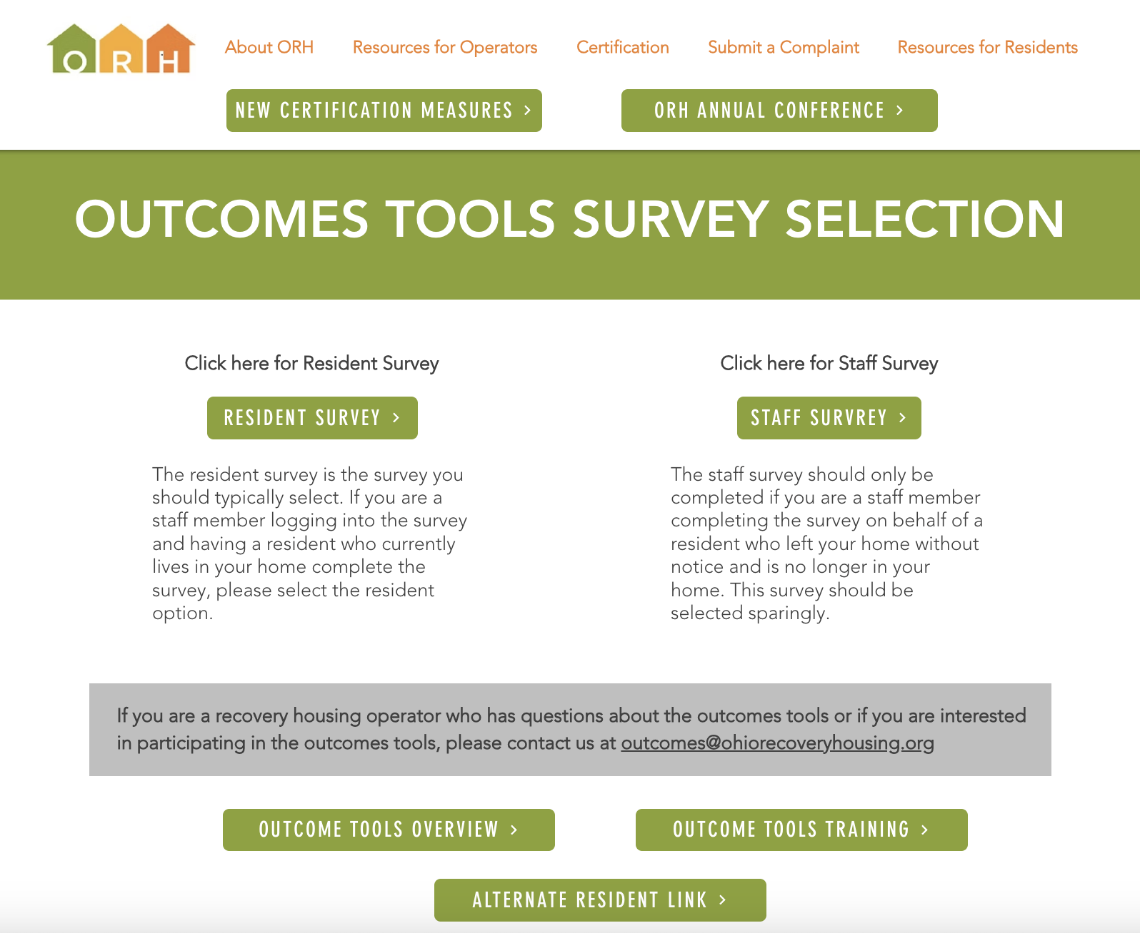
Your Data
If you are using the ORH Outcomes Tool, you also have access to your own Data Dashboard that displays aggregated data that is contemporary – meaning, the data are refreshed daily

Slide 36
Dashboards

Slide 37
So… what am I looking at?
You are seeing data trends over time from move-in, six-months, and exit from recovery housing
The data is not perfectly matched because not everyone completes the outcomes tool at move-in, at six-months, and at move-out
Also, at move-out, some surveys are completed by staff and not the resident
For most operators, the smallest data set is for the six-month survey completion. This situation could be connected to two things: (1) Residents leaving prior to reaching six months; (2) Not having a process in place to remember to complete the six-month survey

Slide 38
Annual Reports
We utilize the data in the ORH Outcomes Tool to build Annual Reports for the ORH staff to disseminate. These reports are posted on the ORH website, linked through the newsletter and sent to stakeholders
The data from the annual reports are used for advocacy, education, and to build the knowledge base about recovery housing
We look at all completed surveys for a calendar year when we develop an annual report for ORH
Annual reports are just one way to communicate and share information
Other ways to communicate information include: brief reports, infographics, executive summaries, presentations, etc

Slide 39
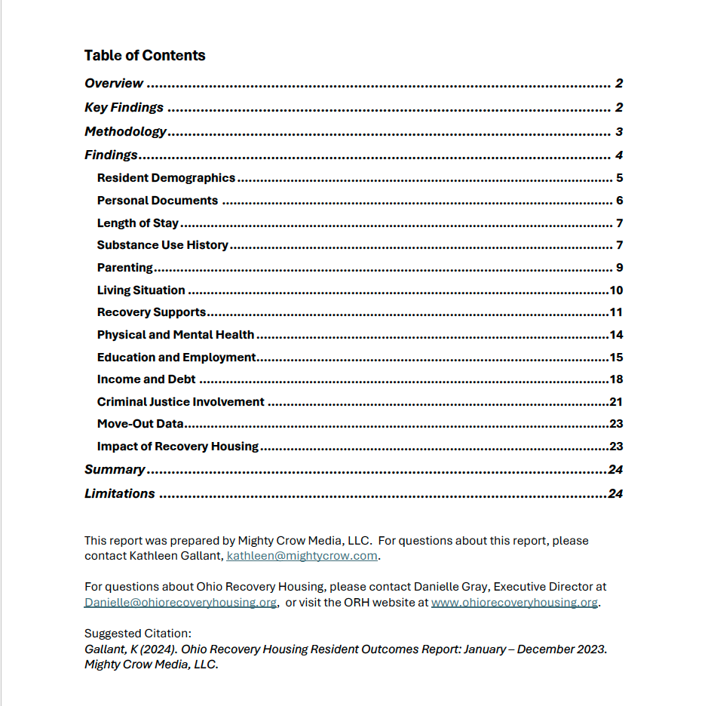

Slide 40
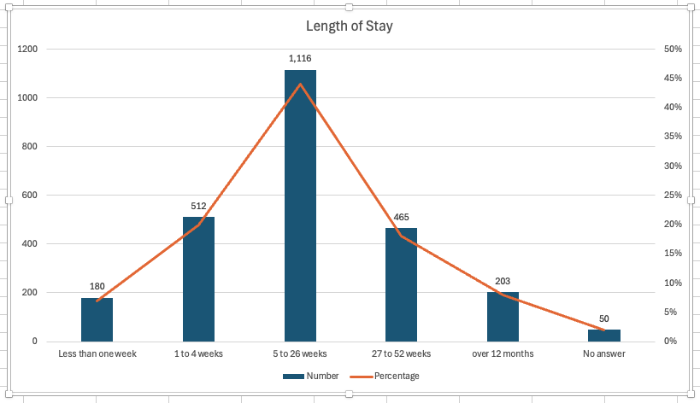
2024 Annual Report: In Process
In calendar year 2024, over 10,000 surveys were submitted through the outcomes tool:
Over 6,000 were done at move-in
900 were completed at the six-month length of stay
Over 2,000 were completed at move-out
Over 400 recovery houses participated.

Slide 43
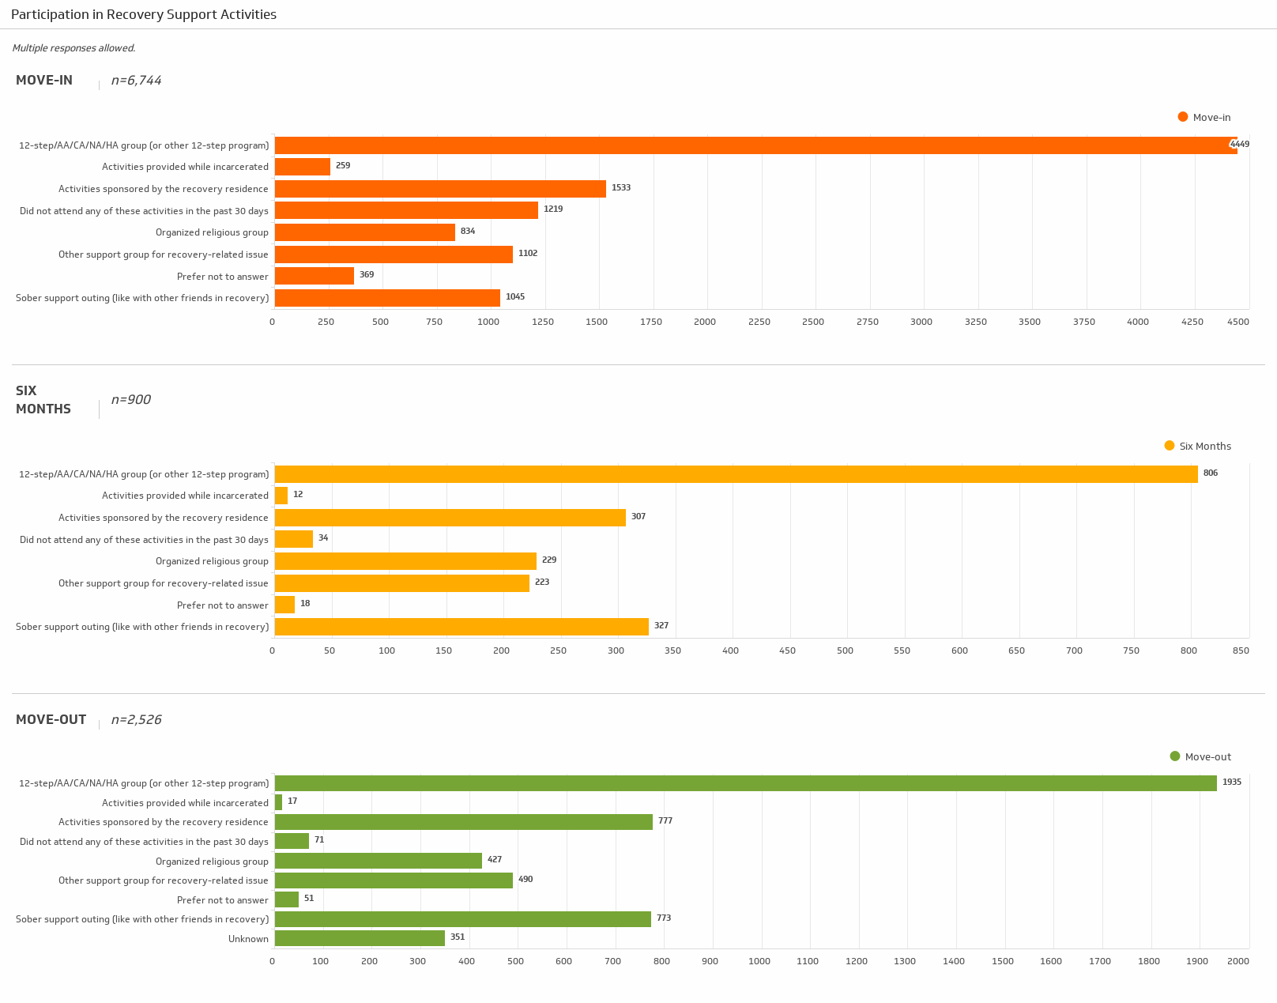

Slide 44
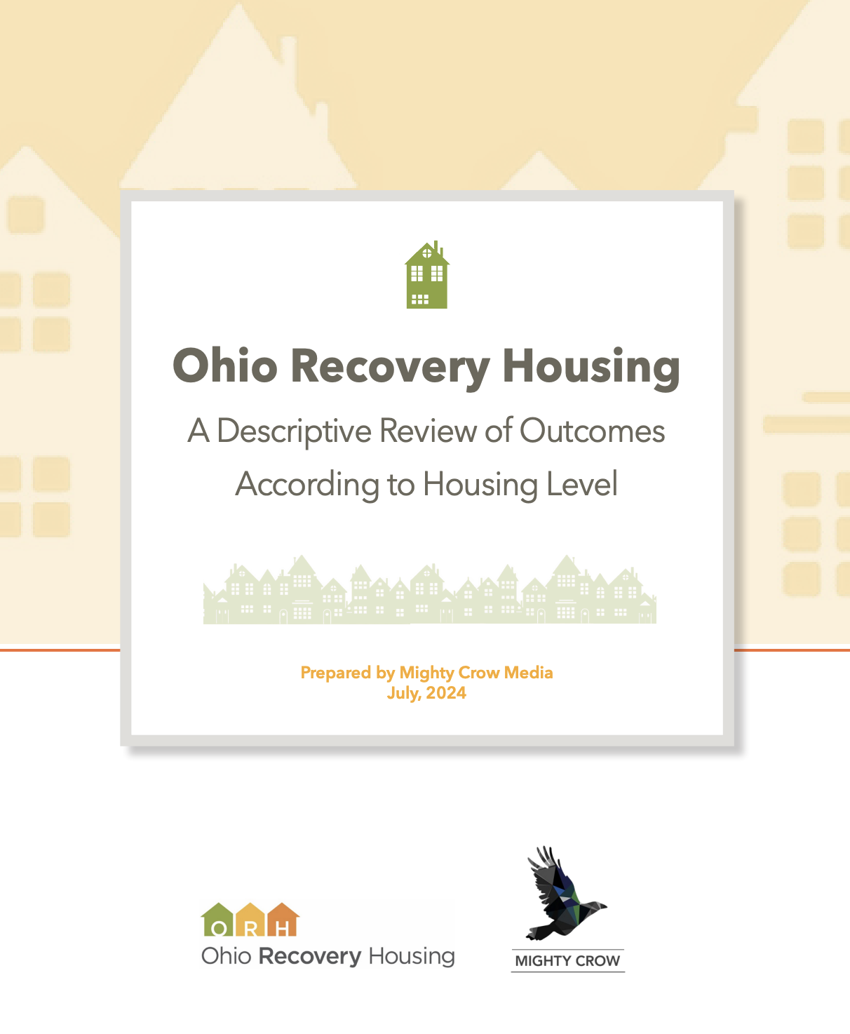
Dr. Brieanne Beaujolais
Kathleen Gallant

Slide 45
Purpose and Scope
Data collected May 1, 2022- Dec 31, 2023
Recovery housing resident outcomes across the multiple levels of housing have not yet been widely studied. Much of the existing research has focused on Oxford Houses, or Level 1 housing.
The purpose of this study was to contribute to the knowledge-base of recovery housing outcomes and explore how resident outcomes may vary by housing level in Ohio.
5,742 surveys from 97 certified houses
Level 1
156 move-in
37 six month
Level 2
3,152 move-in
544 six month
Level 3
1,625 move-in
228 six-month

Slide 46
Research Questions
Is there a change over time from move-in to the six-month follow-up period?
How do these changes compare across the three housing levels?
At move-in only, is there a difference across housing levels in where residents had been living previously?
Demographics (Race, gender, & sexuality
Alcohol/Illicit drug use
Self-ratings of physical/mental health
Use of recovery supports
Involvement with drug court or status of being on probation
Education and/or skilled-training pursuits
Employment

Slide 47
Methods
Extracted data from excel
Prepared data to input into SPSS, a statistical software
Combine response options when there were too few responses (standard practice when data are sparse)
Created composite variables when necessary
SPSS
Descriptive statistics
Chi-square tests of independence to determine whether differences were statistically significant
Effect sizes using Cramer’s V to determine strength of association

Slide 48
RQ1 – Race
RQ1: Is there a difference in the [racial, gender, sexual identity] composition of residents from move-in to 6-month follow-up?
Select all that apply: 16 options; created variable for multi-racial if more than one race was selected
All levels - Most residents identified as White (78.0 – 86.1%)
All levels - Second largest racial group was Black/African American (13.4 – 15.6%)
Reflective of demographics in Ohio
Levels 2 & 3: No statistically significant associations between housing and racial identity, suggesting that there was not a differential rate of drop out. (Too few responses in Level 1 to analyze)
Notes:
Across all three housing levels, there were no statistically significant differences in the racial composition of residents from move-in to the 6-month follow-up. This finding suggests that there was not a differential drop-out rate based on race.

Slide 49
RQ1 – Sexuality
RQ1: Is there a difference in the [racial, gender, sexual identity] composition of residents from move-in to 6-month follow-up?
Select all that apply: 11 response options (collapsed to three categories: straight/heterosexual, gay or lesbian, other sexual minority)
All levels: Most residents identified as heterosexual (66.7% - 86.5%)
Levels 2 and 3: Higher percentages of sexual minority residents at move-in compared to the six-month follow-up period
All levels: No association between sexuality and length of stay
These observed changes, therefore, were not likely a result of recovery housing but rather happened by chance
Notes:
The second most common identification was “Other Sexual Minority Identity” which includes respondents who identified as asexual, bisexual, pansexual, queer, questioning or unsure, other, or who selected more than one option. Gay or Lesbian residents ranged from 2.6% to 11.5%, and a small percentage of residents preferred not to answer.

Slide 50
RQ2 & RQ3
RQ2/Q3: Is there a difference in rates of alcohol/illicit drug use in the past 30 days at move-in compared to the 6-month follow-up?
Survey response options: No use, 1-10 days, 11-20 days, 21-30 days, prefer not to answer.
All levels: Decrease in use from move-in to six months. No recent substance use was at or near 100% at six months (97.3% - 100%).
Level 1: More frequently reported that they had not recently used alcohol or illicit drugs, followed by Levels 2 and 3, respectively
Notes:
At each survey interval, respondents are asked to indicate how many days out of the last 30 they have used alcohol and illegal drugs, respectively. The options are: no use, 1-10 days, 11-20 days, 21-30 days, prefer not to answer. That means at the time of move-in, residents are asked about their use in the 30 days before their transition into a recovery house. Residents may have been living in unsafe situations (e.g. on the street or staying in a home where alcohol and drug use was present), or they may have been in a safer situation like a treatment setting or a hospital. Thus, their response to this question may be influenced by their living situation.
Level 1, Six months: Percentage of residents who reported no use increased for both alcohol and illegal drug use.

Slide 51
RQ2 & RQ3 (continued)
Levels 2 & 3: Significant and strong association between alcohol use and length of stay (χ2(3) = 80.25, p < .001, V = .15 and χ2(3) = 66.11, p < .001, V=.19 respectively)
The decreased use of alcohol and/or illegal drug use from move-in to six-months was not likely due to chance and that recovery housing may have contributed to the change

Slide 52
RQ4
RQ4: Is there a difference in residents’ self-ratings of physical and mental health ratings at the time of move-in compared to the 6-month follow-up?
Survey response options: [Good] [Fair] [Poor] on most days
Level 1, Move-in: Larger percentage (compared to 2 & 3) who were “Good on most days”
All levels, Six-months: higher proportions with good mental health (70.3%, 64.2%, and 68.3%) and physical health (64.9%, 65.8%, and 64.4%)
Levels 2 & 3: Significant associations ranging from weak, moderate, to strong
The increase in positive mental and physical health ratings was not likely due to chance alone. Likely that recovery housing had an influence on the residents’ improved mental and physical health ratings
Notes:
Residents are asked to report on their physical and mental health by providing a rating of “good on most days,” “fair on most days” or “poor on most days.” At move-in, the difference between residents reporting their mental health as “good on most days” as opposed to “fair on most days” or “poor on most days” was most notable for Level 1 respondents (59.9% versus 32.2% and 7.9%, respectively). When looking at the data from six-month responses, however, all three housing levels show a similarly high proportion of respondents indicating their mental health is good on most days. This trend was not evident in respondents’ analysis of their physical health, though all three housing levels again showed increased percentages of respondents indicating their physical health was good on most days from move-in to six-months.
These findings suggests that the increase in positive mental and physical health ratings (i.e., good on most days) with a corresponding decrease in less positive ratings (i.e., fair on most days or poor on most days) was not likely due to chance alone and that recovery housing had an influence on the residents’ improved mental and physical health ratings.

Slide 53
RQ5
RQ 5: Is there a difference between the residents’ use of recovery supports from move-in to 6-month follow-up?
Two survey items: Select all that apply - Nine response options; Peer support
All three levels: The number of recovery supports residents reported increased during the length of their stay
All levels, Move-in: Fewer than 50% of respondents utilized three or more supports at move-in
All levels, Six months: Over 50% of the respondents reported using three or more supports at the six-month follow-up period (i.e., 62.1%, 57.2%, and 58.8%, respectively)
Levels 2 & 3: Significant and strong association
Notes:
Utilization of recovery supports increased significantly across all levels. Residents reported more recovery supports at the six-month follow-up compared to move-in.
Residents are asked to identify which type of recovery supports they are using. The number of recovery supports respondents were taking advantage of was calculated from two questions asking them to indicate which recovery supports they use. Residents first choose the recovery supports they use from a list that includes: 12-step/AA/CA/NA/HA group (or other 12-step program), organized religious group, other support group for a recovery-related issue, sober support outing (like with other friends in recovery), activities sponsored by the recovery residence, activities provided while incarcerated, did not attend any of these activities in the past 30 days, and prefer not to answer. Next, they are asked if they have received peer support in the last 30 days (yes, no, or prefer not to answer).

Slide 54
RQ6
RQ6: Is there a difference between involvement with drug court and/or status of being on probation or parole at the time of move-in compared to the 6-month follow-up?
Survey - Four response options
Level 1: Largest proportion (compared to 2 &3) who were uninvolved with drug court and/or parole or probation at move-in and six months
Comparing Levels 2 and 3:
Level 2: Larger proportion of respondents on parole or probation at move-in and six months
Level 3: Larger proportion who were more likely to be participating in drug court at move-in and six months
All levels: Involvement did not vary significantly during the six months
Notes:
Residents are asked their current status with being involved in drug court, parole, or probation.
They can choose as many options as apply from a list that includes: currently on parole/probation, currently participating in drug court, not involved with the criminal justice system, prefer not to answer. For this analysis, an additional category was created called “currently on parole/probation and participating in drug court” to determine how many residents were involved with both categories.
It does not appear that length of stay or housing level contributes to residents’ involvement in the criminal justice system.

Slide 55
RQ7
RQ7: Is there a difference in education or skilled training pursuits at the time of move-in compared to the 6-month follow-up?
Survey: Two items
1. Do you consider your education to be complete
2. If no, prompted to choose what applies to them:
General education/Working toward GED
Vocational school
Skilled training
College
Not involved in the last 30 days
Other
Multiple pursuits (if 2 or more were selected)
Notes:
The percentage of residents who reported no involvement with educational pursuits in the last thirty days declined across all three housing levels. This increase in educational pursuits has practical significance, but the association was only statistically significant for Level 2 housing.

Slide 56
RQ7
RQ7: Is there a difference in education or skilled training pursuits at the time of move-in compared to the 6-month follow-up?
All levels: Percentage who reported no involvement with educational pursuits in the last thirty days declined
Level 1, Both intervals: Larger proportion (compared to 2 & 3) not engaged, but smaller percentage who considered education to be complete
Level 2:
At six months - Increased proportion who were engaged in education or skilled training
Association was small but significant
Increased involvement could be contributed in part to the role of recovery housing
Notes:
The percentage of residents who reported no involvement with educational pursuits in the last thirty days declined across all three housing levels. This increase in educational pursuits has practical significance, but the association was only statistically significant for Level 2 housing.
Compared to Levels 2 and 3, a higher proportion of Level 1 residents reported not being involved in educational pursuits at both survey intervals, but they also had a lower percentage who considered their education to be complete. Across all three housing levels, the percentage of residents who reported not being involved in educational pursuits in the last 30 days declined from move-in to six months.
The association was only significant for Level 2 housing (χ2(3) =17.87, p < .001, V = .1) and this association was small. At the six-month period, the proportion of respondents who were not involved in educational pursuits during the previous 30 days decreased. At the same time, there was an increased proportion who were engaged with vocational school, skilled training, college, or multiple pursuits. The proportion of respondents who considered their education to be complete stayed the same. Therefore, it is likely that the increased involvement in educational pursuits could be contributed, at least in part, to the role of recovery housing.

Slide 57
RQ8
RQ8: Is there a difference in employment at the time of move-in compared to the 6-month follow-up?
Survey:
Part-time paid work
Full-time paid work
Temporary assignment
Looking for work
Retired
Unable to work while incarcerated
Working with institution where incarcerated
Disabled and not receiving disability benefits
Disabled and receiving disability benefits
Unemployed
Other
Notes:
11 response options
Compared to Levels 2 and 3, there was a higher percentage of Level 1 respondents who were working at move-in to recovery housing; this difference was not notable in the six-month results. There were also relatively fewer respondents from Level 1 housing reporting they were unable to work due to incarceration at move-in. Across all levels, the percentage of respondents unemployed or looking for work dropped dramatically when comparing move-in to six-month results. The percentage of respondents disabled and receiving disability benefits increased for all levels, while the percentage who were disabled and not receiving disability benefits declined for Levels 1 and 3. These results suggest that recovery housing may have had a role in helping residents with a disability enroll and obtain disability benefits they were previously eligible for but were not receiving.
A chi-square test of independence was conducted between employment pursuits and length of stay. The small cell sizes precluded analysis of Level 1 housing. The associations between employment pursuits and length of stay for Level 2 housing (χ2(10) = 581.13, p < .001, V = .41) and Level 3 housing (χ2(10) = 298.76, p < .001, V = .41) were significant, and both levels had very strong associations, suggesting that recovery housing played a role in residents’ ability to gain employment and/or receive disability benefits after moving in.

Slide 58
RQ8
RQ8: Is there a difference in employment at the time of move-in compared to the 6-month follow-up?
All levels:
Percentage of unemployed or looking for work dropped dramatically
Percentage of disabled and receiving disability benefits increased
Levels 1 & 3
Percentage of disabled and not receiving benefits declined
Levels 2 & 3
Significant and strong association between employment pursuits and length of stay
Notes:
Compared to Levels 2 and 3, there was a higher percentage of Level 1 respondents who were working at move-in to recovery housing; this difference was not notable in the six-month results. There were also relatively fewer respondents from Level 1 housing reporting they were unable to work due to incarceration at move-in. Across all levels, the percentage of respondents unemployed or looking for work dropped dramatically when comparing move-in to six-month results.
The percentage of respondents disabled and receiving disability benefits increased for all levels, and the percentage who were disabled and not receiving disability benefits declined for Levels 1 and 3.
These results suggest that recovery housing may have had a role in helping residents with a disability enroll and obtain disability benefits they were previously eligible for but were not receiving.
A chi-square test of independence was conducted between employment pursuits and length of stay. The small cell sizes precluded analysis of Level 1 housing. The associations between employment pursuits and length of stay for Level 2 housing (χ2(10) = 581.13, p < .001, V = .41) and Level 3 housing (χ2(10) = 298.76, p < .001, V = .41) were significant, and both levels had very strong associations, suggesting that recovery housing played a role in residents’ ability to gain employment and/or receive disability benefits after moving in.

Slide 59
RQ9
RQ9: At the time residents moved into recovery housing, is there a difference across housing levels in where residents were living?
Survey: Identify previous living situation, select from 17 options (where had they been the longest in past 30 days)
All levels:
High proportion from treatment or detox center (37.7%, 41.1%, 28.8%)
Level 1:
Highest proportion coming from halfway houses or transitional living
Levels 2 & 3:
More came from treatment of detox center than any other place
Notes:
At move-in, residents are asked to identify their living situation(s) for the 30 days prior, choosing from the list in the table below. If they have stayed more than one place, they are instructed to choose where they were the longest.
Differences were apparent amongst housing levels when looking at where respondents had been living in the 30 days prior to move-in to recovery housing. Compared to Levels 2 and 3, the Level 1 respondents more often came from halfway houses or transitional living. In contrast, respondents coming from jail, prison, or an emergency shelter were more frequently going into Level 2 or 3 housing. A high proportion of residents in all levels were moving to recovery housing from a treatment or detox center, though this was most notable for Level 2 housing (41.1.%).

Slide 60
Foundational supports for recovery make a difference
Health: Alcohol and illicit drug use decreased across all three levels. Levels 2 and 3 showed a statistically significant decrease in use, meaning the decline in use was likely due at least in part to recovery housing and not chance alone. (RQs 2 & 3)
Health: Mental and physical health ratings improved across all three housing levels. The improvements were statistically significance for Levels 2 and 3, meaning the improvements were likely due in part to recovery housing. (RQ 4)
Community: Recovery supports increased significantly across all levels. Residents reported utilization of more recovery supports at the six-month follow-up compared to move-in. (RQ5)
Purpose: Employment rates increased and unemployment decreased across all housing levels. These changes were significant, meaning recovery housing very likely had a role in improving employment status. Level 1 residents were more likely to be employed at move-in; by six-months there was no discernible difference in rates of employment across housing levels. (RQ8)

Slide 61
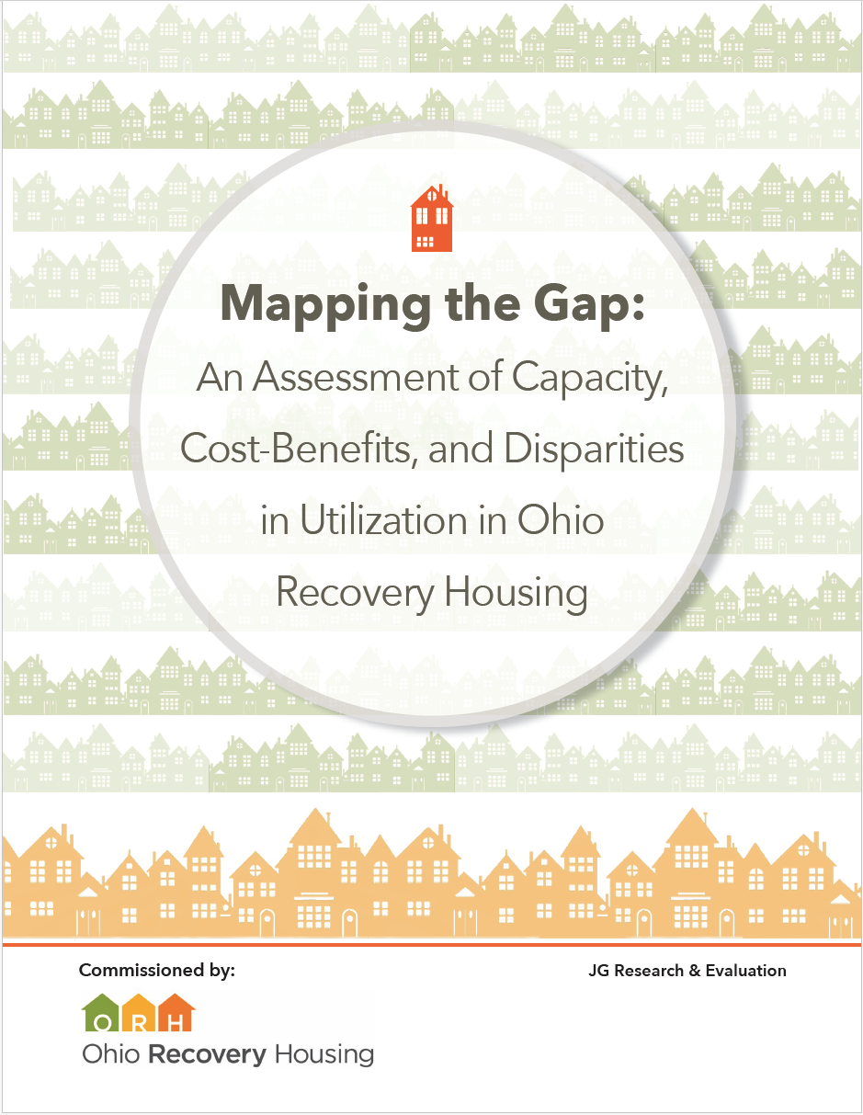
Dr. Brandn Green
JG Research & Evaluation

Slide 62
Mapping the Gap
This capacity assessment was intended to quantify three key questions for ORH:
1. What is the current capacity of the existing bed infrastructure of recovery housing in Ohio and does this meet the projected demand for this service?
2. What are projections for the cost savings to the behavioral health treatment care system in Ohio with additional investments in recovery housing?
3. Are there disparities in access or utilization by geography, race, gender, and socio-economic status for recovery housing?

Slide 63
Key Findings
Across Ohio, 31% of recovery housing capacity is being met across NARR levels, 1, 2 and 3.
Ohio experienced an estimated $35 million in cost savings in 2022 due to the utilization of recovery housing capacity.
If Ohio were to expand access to recovery housing capacity and enrollment by 25%, Ohio would expect to see an additional $8.5 million in cost savings per year.
Including cost savings and benefits to individuals, the overall economic impact due to Ohio’s utilization of recovery housing capacity in 2022 is estimated as $51 million, with another $21 million forecasted if Ohio expands recovery housing capacity by 25%.

Slide 64
Key Findings, continued
Based upon demographic records collected by recovery housing, there are no disparities in utilization of services by race or gender.
The race and ethnicity of residents aligns with the demo- graphics of Ohio, but there is significant variation across regions
There is variation across the state in the capacity of recovery housing, both by Level and by County behavioral health authority regions.
The recovery housing level with the largest gap in capacity (only 8% of total need being met) is Level .
The recovery housing level with the smallest gap in capacity is Level 3 (with 83% of the total need being met)

Slide 67
Risk Assessment using Data Science
Ely Potter, Data Scientist

Slide 68
Study Goals
1. Provide a comprehensive analysis of the impact of recovery housing on resident recovery
2. Construct a risk assessment model that will identify key sobriety and recovery capital risk factors for incoming residents
“Specifically, using findings from an analysis of a resident survey data set, a predictive classification model will be created to help determine the probability that a given incoming resident will disrupt treatment, meaning they will leave the program before the critical six-month mark. Additionally, the model will output which specific survey responses and demographic features impact a given prediction the most.”

Slide 69
Sample Size
Analyzed the original cases from version 1.0 of the Outcomes Tool:
11,500 records
Analyzed the cases from version 2.0 of the Outcomes Tool:
5,000 records
To be able to analyze the two versions of the outcomes tool and surveys, the following steps were taken:
Identify key features
Data Cleaning and aggregation
Construct module for cleaning and encoding data

Slide 70
Model for Analysis
A Pseudo-Ensemble Model was developed for the final product and combined three statistical prediction models:
Logistic Regression Prediction
XG Boost Prediction
Neural Network Prediction
The use of the pseudo-ensemble model resulted in high levels of confidence about the ability to predict disruption prior to six months.

Slide 72
ORH also does a lot of research and evaluation

Slide 73
And, they produce best practice guides

Slide 74
We remain committed to studying recovery housing in Ohio
We plan to continue sharing what we have learned through publications in peer-reviewed journals and through the development of infographics and brief reports.
We hope to conduct another analysis by housing level again with the 2024 data.
We hope to run the 2023 and 2024 data through the data science modeling again to see if the predictive features remain or if they have changed.

