Slide 1
Fostering Healthy Romantic Relationships: A Community Discussion
Gretchen Clark Hammond, PhD, MSW, LSW, LCDCIII, TTS
CEO, Mighty Crow

Slide 2
Welcome!

Slide 3
What are we trying to accomplish in this session?
This session will be a discussion on the vital topic of romantic relationships between residents in recovery housing.
It is a topic that is critically important for our residents, but one that is rarely discussed.
Through collaborative dialogue, we aim to enhance understanding and develop strategies to foster healthy and supportive romantic relationships among residents, ultimately contributing to a more positive and effective recovery environment.

Slide 4
Learning Objectives
1. Identify Key Issues: Facilitate a collaborative discussion to identify and understand the primary challenges and issues related to relationships between residents in recovery housing.
2. Discuss Current Considerations: Explore and share current practices, considerations, and experiences that impact resident dynamics, aiming to enhance mutual understanding and support.
3. Brainstorm Future Initiatives: Engage participants in brainstorming and developing actionable strategies and initiatives that the community can undertake to foster healthier and more supportive relationships among residents.

Slide 5
Check-in
How many of you get calls or questions about recovery housing for couples (two adults) or families (parents with children)?
How many of you provide recovery housing for couples or families?
How many of you have residents who are looking for recovery housing for couples or families as they are planning to move-out?

Slide 6
For Context
Many people live with someone for most of their lives. That someone may be:
A parent
A child
A significant other or spouse
A friend
A family member
There are many reasons to live with someone:
Financial cost sharing/savings
Social needs and feeling less isolated
Caregiving needs or safety needs
Other shared resources
Romantic/emotional reasons

Slide 7
Additional Context
We don’t have a lot of options for couples and/or families in our current stock of recovery housing.
This situation may be because of the type of housing we own and operate
This situation might be because we have not envisioned how to create recovery housing that supports couples and families
This situation may be because we are not certain how to approach relationships…

Slide 8
Let’s Imagine for a Moment
We had an opportunity to create more recovery housing that could accommodate two people in recovery who want to live in recovery housing together, or for a family (one adult or two adults with children) who want to live in recovery housing together.

Slide 9
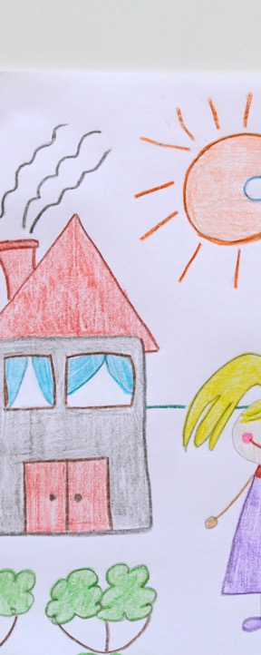
The Residents
Who do you think are the residents who would want this type of housing?
People in early recovery
People in middle recovery
People in long-term recovery
Younger people
Older people
I’ve heard many times over my career, “I wish there was a neighborhood I could live in where I knew everyone else was in recovery.” People think about this as they are working, raising their children, and wanting to maintain their life in recovery. They think about it as they age, lose their spouse, and worry about being older and in recovery without the supportive people who understand what it means to be in recovery.

Slide 10
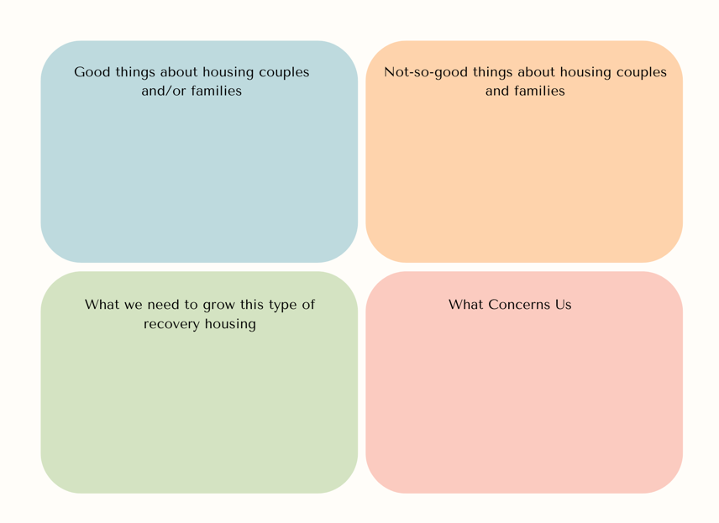

Slide 11
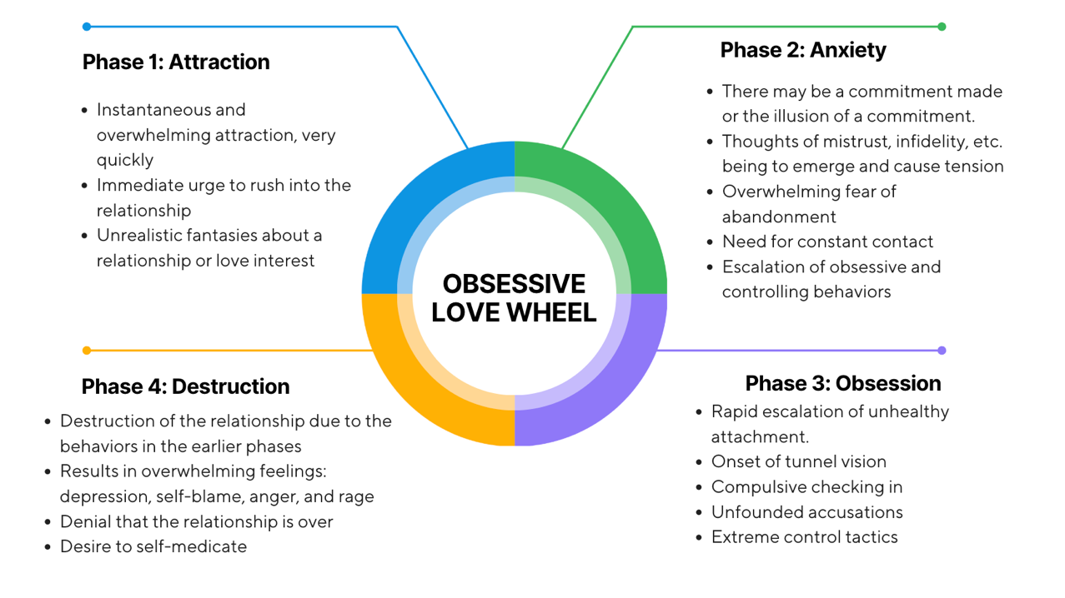

Slide 12
7 Types of Emotional Baggage

Slide 13
We may acquire our emotional baggage in the midst of experiences of tragic loss. We may have experienced an irreplaceable loss of safety in our living situation, self confidence in our abilities, courage to take additional risks, self respect in order to expect respect from others, or many other personal qualities we value. Within this frame, baggage is the scar from such a deep loss.
We may come by lasting emotional baggage from someone's else's baggage showing up in our face or on our case. We feel either trapped by their aggression or challenged to fight back with an alarmed sense of chronic danger. Our baggage keeps us safe amidst continuing threats to our survival.
We may experience emotional baggage as drawing a blank, being speechless, coming up with nothing to say or other blockages to our self expression. Others may have silenced our unique voices, the display of our feelings, or unconventional point of view. Our baggage keeps us stifled, inhibited, or blocked from realizing our hidden talents, exceptional gifts and valuable character traits.

Slide 14
We may find our baggage taking control of episodes of our life. We may repeatedly sabotage attempts at business success, personal relationships or new projects at home. Our baggage may contain a belief system about our dreadful destiny, cruel fate or perpetual bad luck -- that plays itself out in our lives on occasion.
Our emotional baggage can make us very difficult to get along with or be patient with our shortcomings. We're possessed by something other than the side of our personality which makes a good impression, shows interest in others and earns the respect of people we admire.
Our baggage invents disguises so we appear to not have any baggage. We hide the fact we've been shocked by what happened to us years ago. We pretend to be in control of our lives now. We put on a show of compatibility, confidence and cleverness. Our baggage lurks behind the mask it concocted.
Our baggage represents the decision we made in haste, while feeling desperate and frothing with self-incriminations. We perpetually live with the consequences of having been so wrong, vulnerable, foolish, unguarded or trusting at that moment when the decision was made.

Slide 15
Family Rules that Come from Trauma and Dysfunction within Active Addiction
From Claudia Black’s Work on children of alcoholics (1987), “It Will Never Happen to Me”:
1. Don’t Talk.
2. Don’t Trust.
3. Don’t Feel.

Slide 16
Roles in the Addicted Family System
The Enabler
The Hero
The Scapegoat
The Lost Child
The Mascot

Slide 18
From Celebrating Families! (a curriculum specifically for families in recovery from SUD)
Healthy Families:
People feel free to talk about feelings
Believe feelings are OK
People are more important than performance
All subjects are open for discussion
Respectful criticism
Growth is celebrated
People feel loved
Clear, flexible rules vs. inconsistent and rigid
Each person is responsible for their own actions

Slide 19
Knowing what we know, what could the future look like?
Brainstorm Future Initiatives: Let’s develop actionable strategies and initiatives that the community can undertake to foster healthier and more supportive relationships among residents.

Slide 20
Wrapping Up
1. Identify Key Issues: Facilitate a collaborative discussion to identify and understand the primary challenges and issues related to relationships between residents in recovery housing.
2. Discuss Current Considerations: Explore and share current practices, considerations, and experiences that impact resident dynamics, aiming to enhance mutual understanding and support.
3. Brainstorm Future Initiatives: Engage participants in brainstorming and developing actionable strategies and initiatives that the community can undertake to foster healthier and more supportive relationships among residents.

